Slide 1
The Church
Key vocabulary

Slide 2
Domestic Church

Slide 3
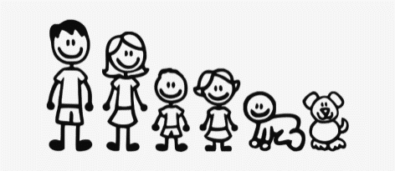
Domestic Church - Myself
Christian
family name
precious
parent
God
love
loving parent
prayer
EYFS

Slide 4
Domestic Church - Families
Family
belong
God
love
care
different
God’s children
psalm
family of God
response
‘Blessed be God’
Year 1

Slide 5
Domestic Church - Beginnings
beginning
family
friend
creation
psalm
litany
new start
prayer
‘And God saw that it was very good’
‘Blessed be God’
created in God’s image.
Year 2

Slide 6
Domestic Church - Homes
home
love
family
difference
respect
joys
sorrows
community
holy family
‘Love one another as I have loved you’(Jn15:12)
‘Put up with one another…’(St Paul Colossians)
Year 3

Slide 7
Domestic Church - People
chosen people
roots
family tree
genealogy
Old Testament Abraham
Sarah
Isaac
Jacob
Ruth
Naomi
‘Wherever you go, I will go.’
Solomon
God’s will
God’s promise to his people
trust in God
‘Father of a great people’’
“descendants number more than the stars”
Abraham trusted God.
Year 4

Slide 8
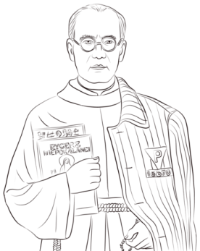
Domestic Church - Ourselves
unique
gifts
challenge
joys
responsibility
dignity
image
holy people
courage
martyr
Mary mother of God.
sacrifice
missionary
canonized
bore witness
rosary
Maximilian Kolbe
Year 5

Slide 9
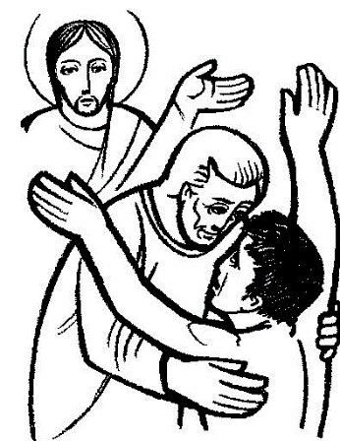
Domestic Church - Loving
unconditional
forgiveness
mercy
Prodigal
parable
beatitudes
sacrament reconciliation
‘Make your home in me as I make mine in you’(John 15:4)
‘Walking in darkness’
– Resurrection – ‘I am the light of the world’ John 8:12
Year 6

Slide 10
Local Church

Slide 11
Local Church Celebrating
church
Priest
celebrate
celebrating
parish family
community
Temple
parish
EYFS

Slide 12
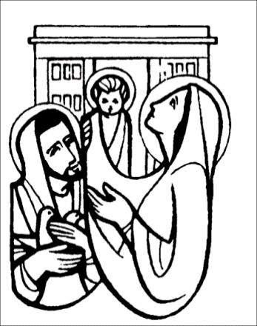
Local Church Special People
welcomers
Sunday
holy
Jesus
presentation
Mary
Joseph
Anna
Simeon
church
community
temple
altar servers
special ministers
readers
choir
priest
sign of the cross
‘Thanks be to God’
Year 1

Slide 13
Local Church Books
Books
scripture
lectern
Gospel
Matthew
Mark
Luke
John
Bible
Word of God
New Testament
Old Testament
genre
thurible
incense
missal
church
parish family
Sign of the Cross
‘Glory to you O Lord’
‘Praise to you Lord Jesus Christ’
‘This is my beloved Son…’
Year 2

Slide 14
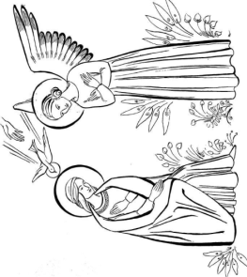
Local Church Journeys
liturgical year Christian family
rosary
calendar seasons
Journey
ordinary time
feasts
Mary
pilgrimage
psalms
annunciation
Mother of God
Incarnation
‘He will be great and will be called the Son of God.’
‘I am happy to do whatever God wants.’
Year 3

Slide 15
Local Church Community
commitment
responsibility
parish
laity
ministries
pastoral areas
service
funeral rites
deanery
extraordinary ministers
‘ called out and set apart’
‘Sharing the mission’
‘Be real about loving’
whole-hearted
enthusiastic
‘Eternal rest grant unto them..
Year 4

Slide 16
Local Church Mission
mission
bishop
ecumenism
cathedral
apostle
disciple
good news
diocese
inspirational
Baptism
Christian unity
gentile
‘Christ is like a single body, which has many parts..’
church – ‘ called out and set apart’
mission – ‘being sent’
‘make the name of Jesus known and loved’
Year 5

Slide 17
Local Church Sources
poetry
prose
history
information
stories
bible
Old Testament
New Testament
genre
letters
gospels
prophets
wisdom
history
acts
revelation
bible ‘inspired by the Holy Spirit’
reverence expressed in the liturgy
‘The Word of the Lord’ and ‘The Gospel of the Lord’
Year 6

Slide 18
Universal Church

Slide 19
Universal Church Our World
world
wonder
wonderful
care
love
share
work
play
together
EYFS

Slide 20
Universal Church Neighbours
neighbour
love
world
fairtrade
global
family
Good Samaritan
parable
psalm
share
‘Who is my neighbour?’
Year 1

Slide 21
Universal Church Treasures
treasure
gift
care
love
protect
respect
preserve
creation
precious
‘Glory to God in the highest..’
Year 2

Slide 22
Universal Church Special Places
special
holy place
world
pilgrim
pilgrimage universal temple
Nazareth
Bethlehem
Jerusalem
Year 3

Slide 23
Universal Church God’s People
ordinary
extraordinary
admire
saint
martyr
communion of saints
peace
justice
living out belief
faith
Oscar Romero
archbishop
St Teresa of Calcutta
Martin Luther King
Year 4

Slide 24
Universal Church Stewardship
stewards
Stewardship
sustainable
creation
creator
climate
preserve
ecology
integrity
harmony
called to stewardship
Catholic social teaching
environment
eco –system
St Francis of Assisi
‘Learn to do good; see that justice is done’
Year 5

Slide 25
Universal Church Common good
justice
peace
integrity of creation
beatitudes
common good
injustice
respect
solidarity
difference
social justice
dignity
Catholic social teaching CAFOD
fairness
gospel values
‘when I was hungry…’ (Matthew 25:31-40)
‘Aspire not to have more but to be more’ (Oscar Romero)
Year 6

