Slide 1
Other Faiths
Key vocabulary

Slide 2
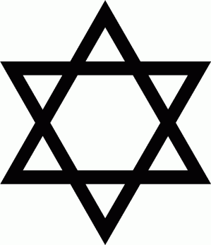
Judaism
special days latkes
Dreidel
Jewish
Hanukkah
festival of light
menorah
lamp
temple
eight days

Slide 3
Judaism
stories Abraham Moses
leaders
Jewish
desert promised Pharaoh
creation shabbat challah havdalah
spice box Kiddush
5-7

Slide 4
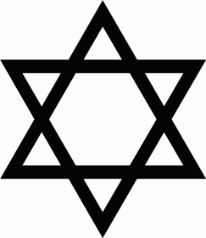
Judaism
worship synagogue shul
rabbi Shabbat sefer
Torah
bimah kippah
tallit
prayer shawl kiddush
books
tenakh
sefer
torah Hebrew scroll scribe yad
ark
bar mitzvah
bat mitzvah
7-9

Slide 5
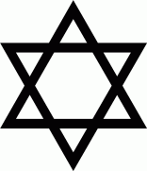
Judaism
remembering Passover
Seder
Pesach
kosher
matzah
bitter herbs charoset
lamb
shema
Exodus
mezuzah
Moses
Pharoah
Rosh Hashanah Teshuvah
Yom Kippur
shofar forgiveness confession responsibility
atonement
fasting
sins
repentance mikveh
Sukkot
Deuteronomy
9-11

Slide 6
Islam
Special object
precious prayer mat book
Qur’an
Muslim

Slide 7
Islam
Muhammad Makkah Ka’bah
prayer
Allah
wudu
Halal
Qur’an
5-7

Slide 8
Islam
wudu mosque
Imam Makkah arabic minaret
muezzin mihrab
Qur’an subhas
Jibril Muhammad
Allah
prayer beads
99 beautiful names
7-9

Slide 9
Islam
Ramadan fasting
Eid-ul-Fitr pilgrimage Makkah
Allah
Ka’bah
Eid-ul-adha
guidance Shahada Salah
Zaka
Sawm
Hajj
pillars
belief
Sadaqa
purification
Growth
Hijja
9-11

