Slide 1

Sacraments
Key vocabulary

Slide 2
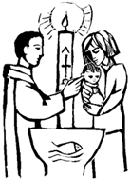
welcome
welcomed
baptise
water
candle
priest Baptism
white garment godparent
font
sign of the cross
oil
EYFS

Slide 3
sign of the cross
belonging
invitation
reply
accept
welcome
Godparents
sign
sacrament
oil
font
symbol
water
Baptism
oil of chrism
‘I baptise you in the name of the Father..’
‘Receive the Light of Christ’
Scripture reading
white garment
anointing
Our Father
promises
white garment
candle
promises
blessing
Easter candle
5-7

Slide 4

Rite of Baptism
litany of saints
welcome
Godparents
sign
sacrament
oil
font
symbol
water
commitment
Baptism
oil of chrism
‘I baptise you in the name of the Father..’
‘Receive the Light of Christ’
Scripture reading
white garment
Our Father
baptismal promises
blessing
white garment
candle
‘What do you ask of God’s church for..?’
faith
blessing
Easter candle
anointing
Year 3

Slide 5

chosen
response
sacrament
oil of chrism
mitre
crozier
sponsor
catechist
bishop
Holy Spirit
witness
Holy Trinity
enkindle
Samuel
apostles
called
‘Come Holy Spirit fill the hearts..’
Liturgy of the Word
Old Testament
New testament
Gospel
Psalm
Christ-like
laying on of hands
presentation of the candidate
gifts of the Spirit
renewal of Baptismal promises
anointing with Chrism
‘Be sealed with the gifts of the Holy Spirit’
‘soldier of Christ’
Confirmation
Year 4

Slide 6
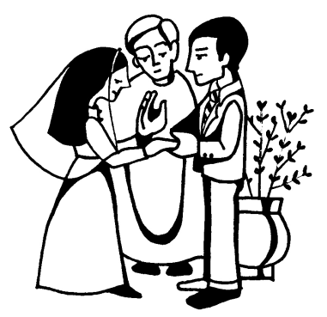
vocation
service
fidelity
commitment
mission
promises
blessing of rings
calling
consecrate
make holy
matrimony
Rite of Marriage
‘Are you ready to accept..’
consent
exchange of vows
‘Are you ready freely..’
Song of Songs
‘Are you ready to love..’
‘Take this ring..’
Nuptial Blessing
‘Nothing can come between us and the love of Christ’ (Romans 8:31)
Marriage
Year 5

Slide 7
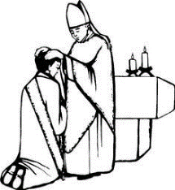
commitment
dedicated
vocation
sacrament
anointing
religious life
service
celibacy
poverty
chastity
obedience
vows
called
Baptism
Bishop
oil of Chrism
stole
chalice
paten
litany of saints
vestments
chasuble
John Henry Newman ‘God has created me.’
‘makes holy and set apart’
‘priestly people’
Holy Orders
‘You did not choose me, I chose you’
presentation of the candidates
examination of the candidates
promise of obedience
laying on of hands
investiture
kiss of peace
Ordination
Year 6

Slide 8

Eucharist
Welcome
‘The Lord be with you..’
Blessing
bless
Mass
altar servers
priest
Crucifix
hymn books
gathering hymn
EYFS

Slide 9
Eucharist
Mass
Share
blessing
bread
host
wine
altar
last supper Holy Communion
listen
give thanks
preparation of the Gifts
‘This is my body’
‘This is my blood’
Our Father
‘Blessed are you Lord God of all creation’
‘Blessed be God forever’
5-7

Slide 10
Eucharist
Mass
share
blessing
bread
host
wine
altar
last supper
Holy Communion
listen
give thanks
preparation of the gifts
‘This is my body’
‘This is my blood’
Our Father
‘Blessed are you Lord God of all creation’
‘Blessed be God forever’
thanksgiving
Eucharistic prayer
‘The Word of the Lord’
‘Thanks be to God’
‘The Gospel of the Lord’
Holy, Holy, Holy.’
‘Go in peace’
‘Thanks be to God
‘The Gospel of the Lord’
‘Praise to you Lord Jesus Christ’
‘Do this in memory of me’
7-9

Slide 11
listening
Sharing
Mass
gathering
Liturgy of the Word
Liturgy of the Eucharist
Holy Communion
ambo
‘The Lord be with you’
‘And with your Spirit’
The Gloria
preparation of the gifts.
‘Blessed be God for ever..’
‘Take this all of you and eat of it , this is my Body’
‘Do this in memory
of me’
Communion
Eucharist
‘Lord I am not worthy..’
‘Do this in memory of me
community
gathering
giving
receiving
liturgy of the word
penitential rite
lamb of God
sign of peace.
introductory rite communion rite
‘Lord I am not worthy..’
Concluding Rite
Take this all of you and eat of it , this is my body’
‘..all of you and drink from it , this is my blood..’
’
‘Behold the Lamb of God’
7-9

Slide 12
Eucharist
memories
significant
memorial sacrifice Passover
Pesach
host
chalice
Seder meal
liturgy of the Eucharist
Eucharistic prayer
consecration.
Mystery of Faith adoration
genuflect
communion, community
unity
‘May they be one..’
Our Father
Sign of Peace
Communion Rite
‘As there is one loaf, so we, although there are many of us..’
‘Lamb of God’
‘supper of the Lamb’
‘Lord I am not worthy..’
unity of the faithful
Eucharistic presence of Christ
9-11

Slide 13
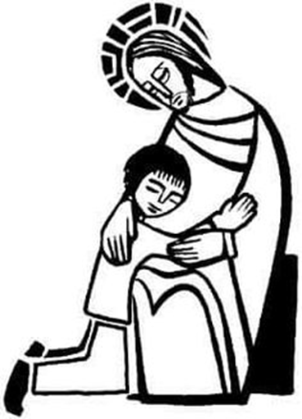
friend
happy
sad
love
make up
kind
gentle
loving
sorry forgive change
rule understanding
new start friendship forgive
Reconciliation
EYFS

Slide 14

choice
happy
sad
disappointed
sorry
forgive
rules
wrong
right
feeling
care
safe
sorry
forgive
right
wrong
make up
choices
sin
consequences examination of conscience
‘wrong on purpose’
purple stole
priest
sacrament
‘Love one another as I have loved you’
laying on of hands
repentance
love
Reconciliation
5-7

Slide 15
confession
conscience
act of sorrow penance
sin
choice
consequences repentance
penitent
absolution
laying on of hands
purple stole
priest
lost sheep
prodigal Son
forgiveness
conversion
‘O my God because you are so good..’
words of absolution
Bridges
penitential rite friendship
contrition
forgiveness
examination
of conscience
sin
penance
Firm purpose of amendment
Reconciliation
7-9

Slide 16

Ten Commandments
greatest Commandment
beatitudes
Christian living
freedom
responsibility
reconciliation
merciful God
absolution examination
of conscience
sin
penance
confession
words of absolution
repentance
penitent
absolution
laying on of hands
purple stole
priest
Reconciliation
Year 5

Slide 17

anointing
prayer
healing
forgiveness of sin care of the sick hospice compassion sacrament parable ‘Who is my neighbour?’
Good Samaritan, Lourdes
mercy
spiritual healing giving strength peace
courage forgiveness
‘..anointed many who were sick.’ (Mark 6:13)
Sacrament of anointing, penitential rite, litany
laying on of hands,
holy water baptism
Sacrament of the Sick
Year 6

