Slide 1

Women in the Bible
Miriam
Sister of Moses

Slide 2
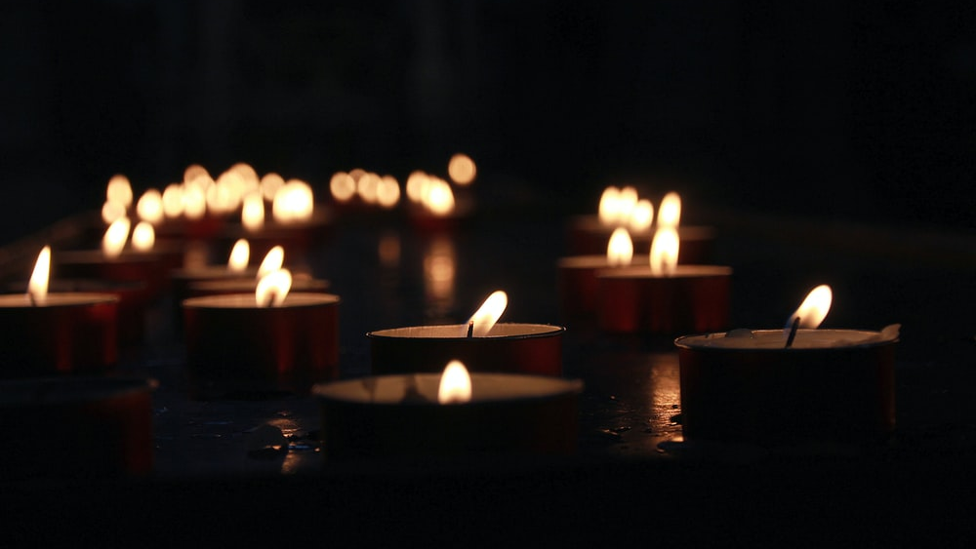
Let us pray

Slide 3

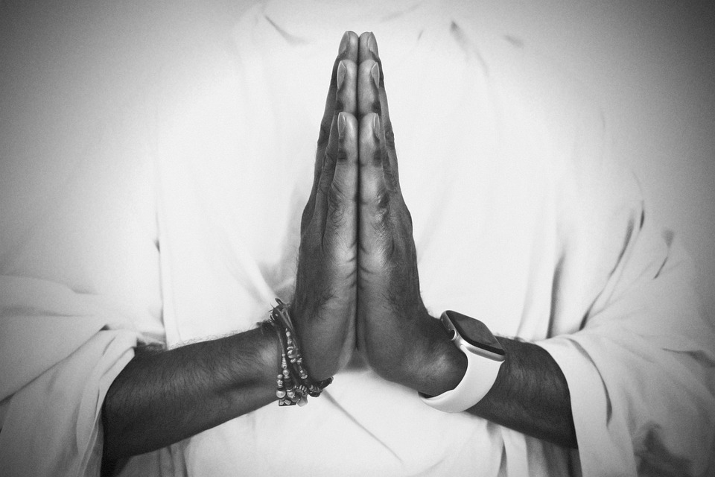
Opening Prayer
Risen Lord, The angel that announced your rising spoke to an audience of but a few women from Galilee.
And then you appeared, risen in the body, but first only to Mary of Magdala.
We look back on all the centuries of your Church
Born of this small, faithful band, Nurtured through the ages so often by the special grace given to women.
Lord, teach us to honour women, in body and in spirit.
For these great disciples have taught us to heal the sick, to feed the poor, to sow mercy and justice and
to make peace.
And we call on them now to pray for us, As we take up the cross ourselves.

Slide 4
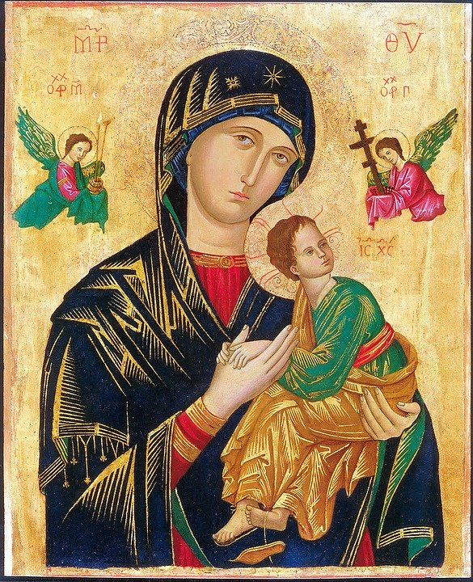
Women in the Bible
There are many notable female characters and heroes across scripture. A few, including Ruth, Esther, and Judith, emerge as especially prominent and even have whole books named after them; but there are others that have only a small appearance in the Bible, some as few as one verse.
Many of the women in the Bible were strong, capable women; they didn’t sit around waiting for someone else to get the job done. They feared God and lived faithfully. They did what they needed to do.
God empowered all women to be strong and follow his call, and he used the actions of these women to inspire and teach us years later through the biblical text.

Slide 5

Bible Women Facts!
Women or women's names represent less than 8 percent of the total names in the Bible!
There are 93 women who speak in the Bible, 49 of whom are named!
Abraham's wife Sarah holds the distinction of being the only woman in Scripture where her age at death is recorded. She died at the age of 127 (Genesis 23:1).

Slide 6
Bible Women Facts!
Deborah was the only woman Judge over ancient Israel (Judges 4:4). She performed this important responsibility for forty years, from 1192 to 1152 B.C.
The book of Esther, written by her and Mordecai, is one of only two Biblical books that do not directly reference God (the other is the Song of Solomon). Esther's book and the one named after Ruth are the only two Biblical writings penned by women.

Slide 7
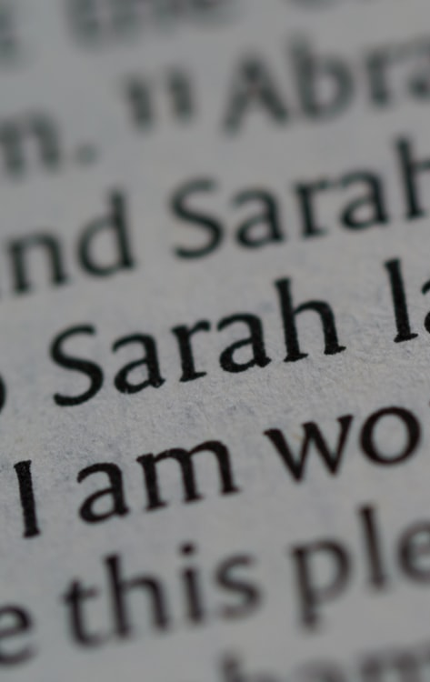
The Most Mentioned Women In The Bible
Old Testament
1. Sarah (41), Sarai (17), Sara (2) = (60 times in total)
Abraham’s wife Sarah, the name she was most commonly called in the Scriptures, is the most mentioned woman in the Bible. Before God changed her name to Sarah, she went by the name of Sarai. Her names are found a total of 60 times in the Bible.
The Rest Of The Top 5 Women
2. Esther (56 times in total)
3. Rachel (47 times in total)
4. Leah (34 times in total)
5. Rebekah (30 times in total)

Slide 8
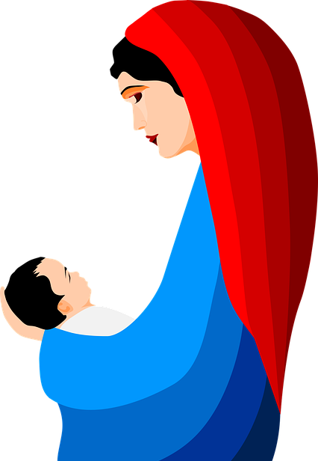
The Most Mentioned Women In The Bible
New Testament
Mary, the mother of Jesus is the most mentioned woman in the New Testament.
In addition to Mary’s name appearing 19 times in the New Testament, she is also referred to a number of other times in the Bible as the mother of Jesus.
Mary Magdalene is mentioned 12 times by name in the New Testament.
In June 2016 she was acknowledged by the Pope as Apostle to the Apostles

Slide 9
Miriam
(The sister of Moses)

Slide 10
Miriam and Moses
Miriam was the daughter of Amram and Jochebed, and the older sister of Moses and Aaron, all of whom were Levites and provided assistance to the priests in the Jewish temple. We first learn of Miriam as she and her three-year-old brother, Aaron, are welcoming a new child into the family.
Unfortunately for that time, the baby was a boy, and there is a decree that all Hebrew baby boys be killed. Miriam had godly parents who trusted the God of Israel, however, Egypt’s Pharoah hated her people. Miriam would have been only about 5 years old when this baby, Moses was born.

Slide 11
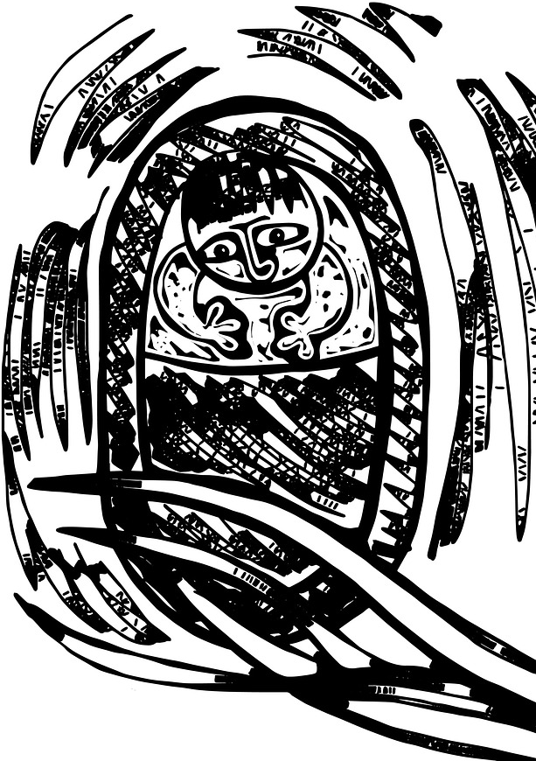
Her mother hid him for three months, but when she could no longer do so, she got a papyrus basket for him and coated it to make it waterproof. Then she placed Moses in it and hid it along the bank of the Nile river. Miriam then watched to see what would happen to him.
When the Pharaoh’s daughter went down to the river to bathe, she noticed the basket and sent a slave girl to get it. After she opened it and saw the baby, she fell in love with him.

Slide 12
At that moment, Miriam bravely stepped forward and offered to find a Hebrew woman to nurse the baby for the princess, who had decided to keep the baby as her own.
And so it was, that Moses’ own mother was paid to care for him until he could be weaned and then given over to the Princess to be raised as an Egyptian.

Slide 13

What does this story tell us about Miriam?
Just from this one incident, we can see that Miriam’s life that she was already caring, capable, and certainly brave.
It would have taken quite a bit of courage to be so direct with the Pharaoh’s daughter.
She must have also been very obedient, because although the Bible doesn’t tell us, it would seem as though her mother had left her to watch over Moses, and see what would become of him.

Slide 14
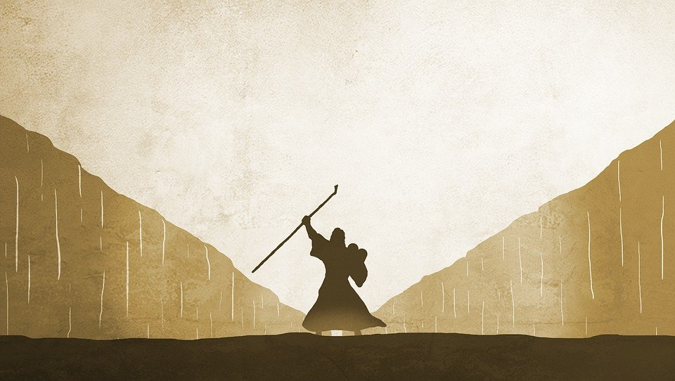
Later in her life, Miriam was there when Moses lead the Israelites across the seemingly impassable barrier of the Red Sea.
Miriam was right there when they looked behind them and saw the chariots of the Pharaoh and all his armies chasing after them. He had changed his mind about letting them leave, and was determined to take them back to Egypt or to kill them on the spot.

Slide 15
She witnessed the miracle when God opened a path through the sea, allowing the children of Israel to walk across on dry land. Again, she was there on the other side when Pharaoh’s chariots and horses followed them along the same path. The massive walls of water that had stood so secure for the Israelites dissolved and drowned the mightiest army of that time.
Miriam recognised that this was God’s triumph and responded by leading others in thanksgiving.

Slide 16
Exodus 15:19 – 21
“For when the horses of Pharaoh with his chariots and his horsemen went into the sea, the Lord brought back the waters of the sea upon them, but the people of Israel walked on dry ground in he midst of the sea. Then Miriam the prophetess, the sister of Aaron, took a tambourine in her hand, and all the women went out after her with tambourines and dancing. And Miriam sang to them:
‘Sing to the Lord, for he has triumphed gloriously;
the horse and his rider he has thrown into the sea.’”

Slide 17
Let us pray

Slide 18
Closing Prayer
St. Miriam, we honour you as one of the most influential saints among the stories in the Bible.
It was you, throughout your life, who guided an enslaved people towards freedom.
Your journey, faith and works combined, have transformed are a sign of hope for all.
How underappreciated, underrated and unsung you were and are.
Let your name be a beacon of hope and refuge for all in need of your guidance and mercy.
Amen

Slide 19
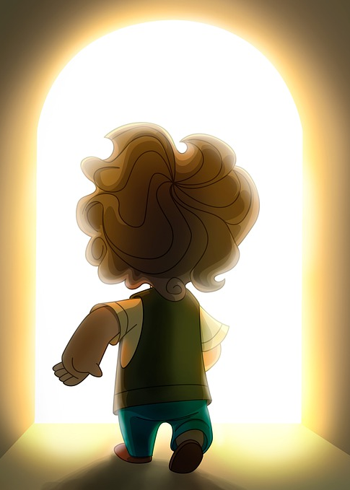
Mission
Miriam led by example; think of ways in which you can be a good role model to others?
Miriam served the people rather than ruled them; in what way can you serve others in your daily life?
Miriam did what she believed God wanted rather than what she wanted to do. In what ways can you be selfless like Miriam?

Slide 20
Women in the Bible
Next Week:
Deborah

