Slide 1
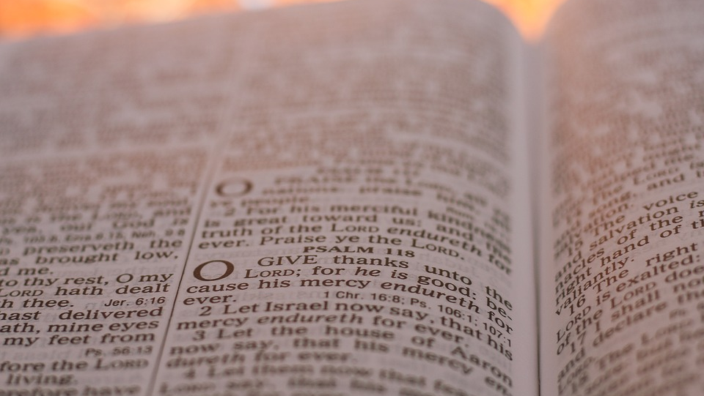



This Week’s Reading: Job 7: 1-4, 6-7
Old Testament Reflection

Slide 2
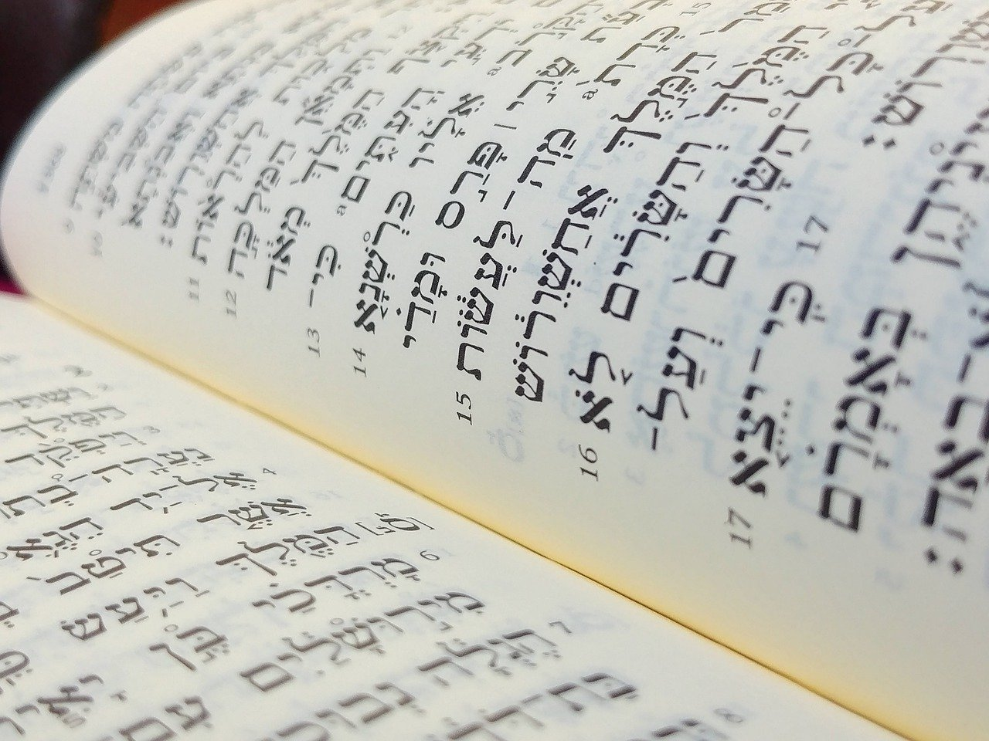
What is the Bible?
Christians believe The Bible is the word of God.
The Bible however is not just one book, but an entire library, with stories, songs, poetry, letters and history.
The Bible has two sections - the Old Testament and the New Testament.
Context

Slide 3
What is the Bible?
The Old Testament is the original Hebrew Bible, the sacred scriptures of the Jewish faith, written at different times between about 1200 BC (Before Christ) and 165 BC.
The New Testament books were written by Christians in the first century AD (Anno Domini) and it contains accounts of Jesus’ life, death and resurrection.
Context

Slide 4
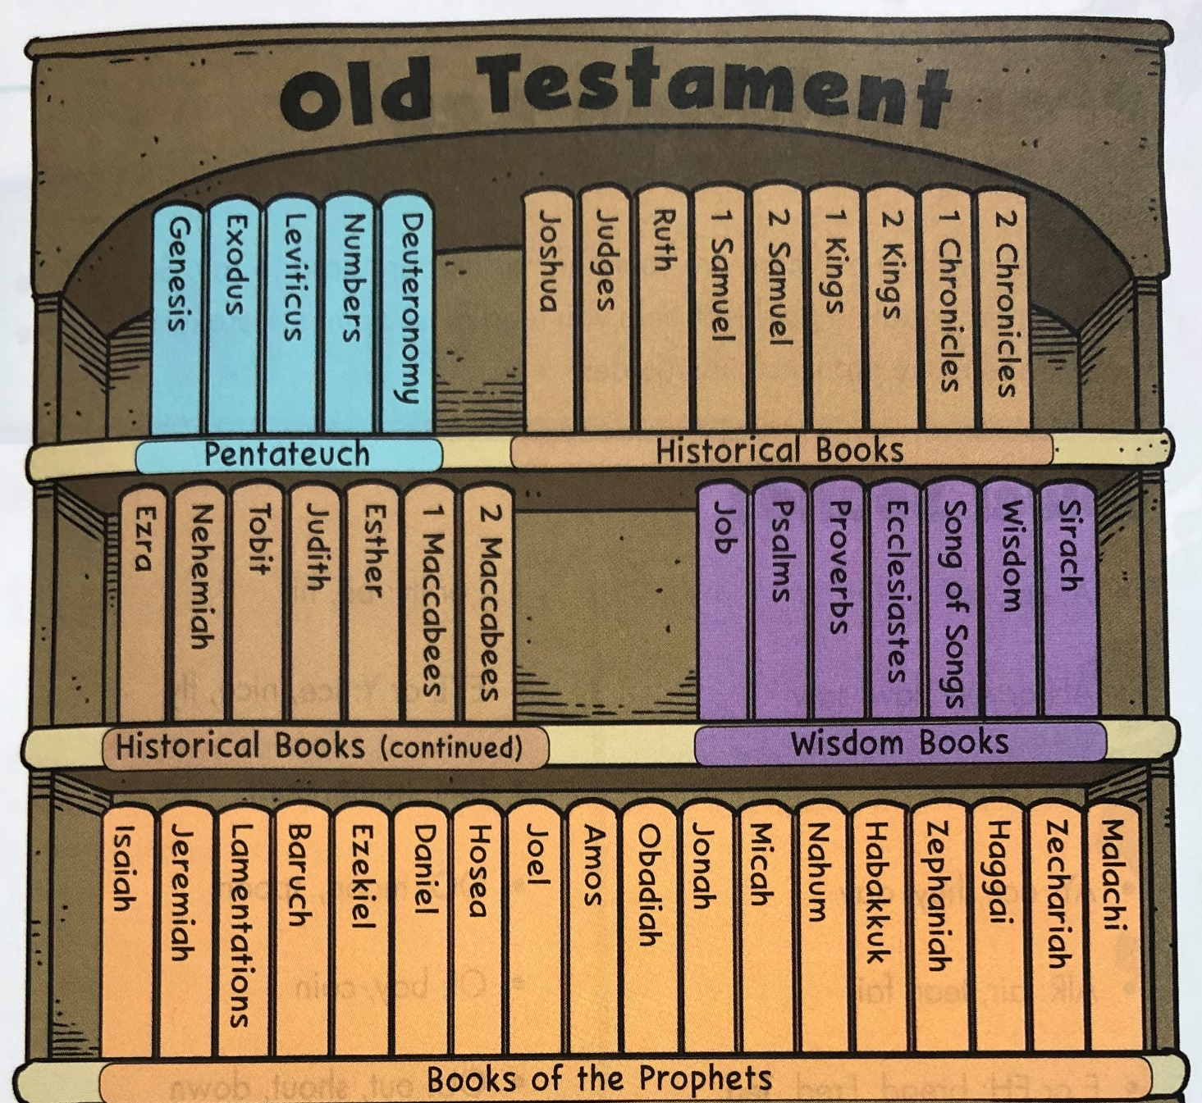
What is The Old Testament?
The Old Testament has 46 books and was written over a long period of time.
It can be arranged into four sections:
The Pentateuch (Law)
The Historical Books
The Wisdom Books
The Prophets
Context

Slide 5
1. The Pentateuch (5 Books)
The first five books, Genesis to Deuteronomy, are not really 'law' Genesis is a book of stories, with nothing like rules and regulations. The other four do contain community laws but they also have many stories. The Hebrew word for Law ('Torah') means 'guidance' or 'instruction', and that could include stories offering everyday examples of how people were meant to live as well. These books were later called the 'Pentateuch’, with Moses being seen as their author.
Context

Slide 6

2. Historical Books
There are 16 ‘Historical Books’ and whilst they are history books, they not only record information, they try to interpret it.
These books try to help people understand the information in these books in relation to other events in the history of Israel, and of the wider world of their day.
Context

Slide 7
3. The Wisdom Books
There are 7 books of wisdom, and these include:
Job (a drama that explores the nature of suffering)
Psalms (songs, prayers and liturgies for worship)
Proverbs (sayings of wisdom)
Song of Songs (love poems)
Context

Slide 8
4. The Prophets
This is the largest section of The Old Testament with 18 books.
These books contain stories of various prophets who reminded people of the values and practices that would reflect the character of God.
Prophecy is a divine message from God and prophets were chosen for different reasons. He gave people opportunities to learn and grow in faith. God wanted His prophets to have to trust Him completely and not rely on their own strength.
Context

Slide 9
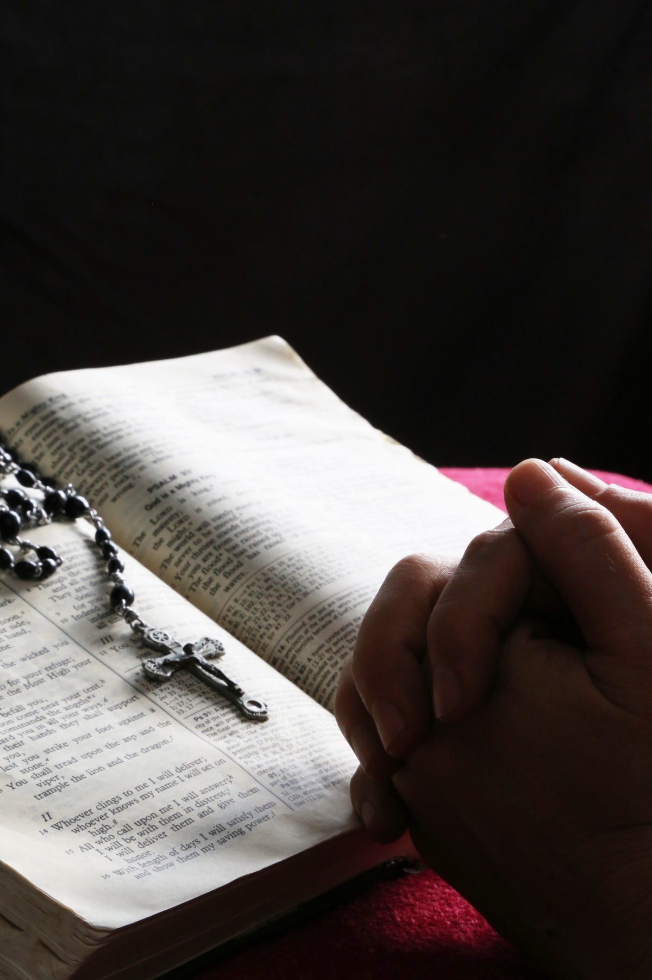
Lord,
Give us wisdom as we prepare to read your word,
clarity for when we read, and understanding whilst we reflect on their meaning.
May your words change our actions and draw us closer to you.
Amen
Gather

Slide 10
Job 7: 1-4, 6-7
This Week’s Reading

Slide 11
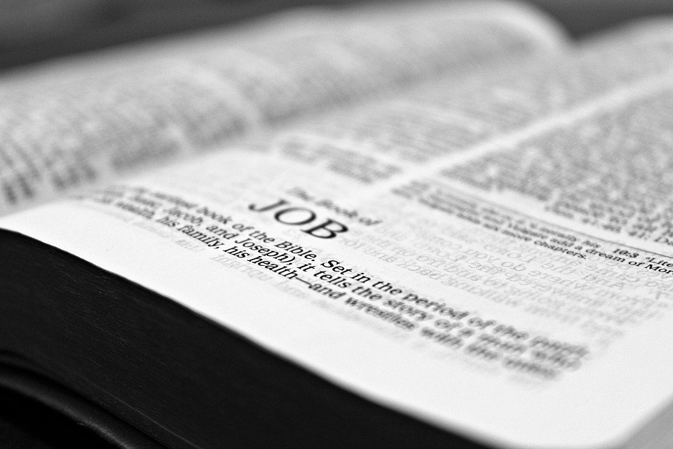
The Book of Job is often counted among the masterpieces of world literature!
It is found in the third section of the biblical canon known as the Ketuvim (“Writings”). The is named after its central character, Job, who attempts to understand the sufferings that surround him and why God permits evil to exist in the world.
It is the first poetic book in the Old Testament of the Christian Bible and scholars are generally agreed that it was written between the 7th and 4th centuries BC.
The Book of Job

Slide 12
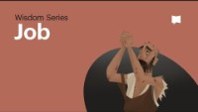
The Book of Job

Slide 13
Restless I fret till twilight fails.
“Do not mortals have hard service on earth?
Are not their days like those of hired labourers?
Like a slave longing for the evening shadows, or a hired labourer waiting to be paid, so I have been allotted months of futility, and nights of misery have been assigned to me.
When I lie down I think, ‘How long before I get up?’
Listen: Job 7 1-4; 6-7

Slide 14
The night drags on, and I toss and turn until dawn.
“My days are swifter than a weaver’s shuttle, and they come to an end without hope.
Remember, O God, that my life is but a breath; my eyes will never see happiness again.
Listen: Job 7 1-4; 6-7

Slide 15

What do you think Job means when he says ‘mortals have hard service’ ?
How is this true more true than ever in the current situation?
How does this reading from Job make you feel?
What can you do ‘today’ to help someone who may be feeling that their life is ‘hard service’ at the moment?
Reflect

Slide 16
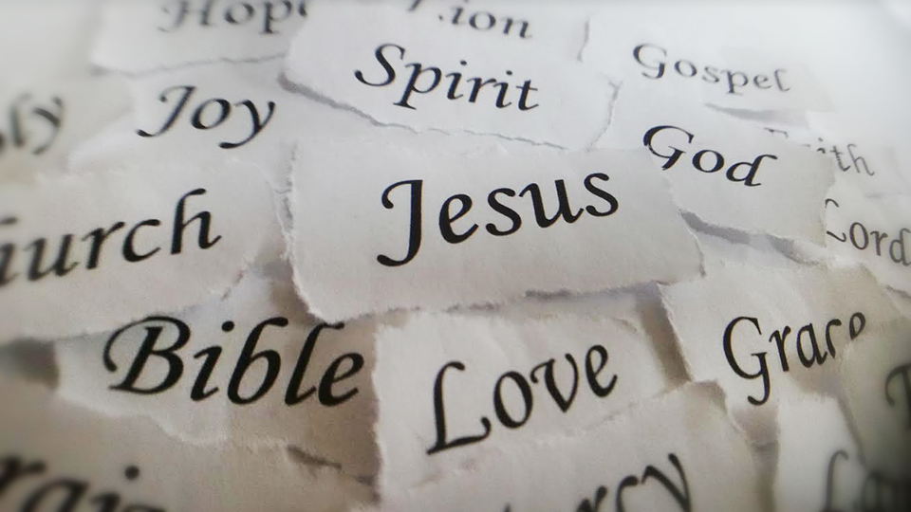
Let us pray

Slide 17
Almighty and all-merciful God,
lover of the human race, healer of all our wounds,
in whom there is no shadow of death,
save us in this time of difficulty;
grant wisdom and courage to our leaders;
watch over all medical people
as they tend the sick and look after those in most need;
stir in us a sense of solidarity beyond all isolation;
if our doors are closed, let our hearts be open.
By the power of your love destroy the virus of fear,
that hope may never die
and the light of hope, the triumph of life,
may shine upon us and the whole world.
Amen.

Slide 18

In the book of Job, the main character attempts to understand the sufferings that surround him.
How can you be a ‘light in the darkness’ for anyone who is struggling at the present time?
What story from the New Testament could you use as an example of hope at this time?
What could you do today to be a sign of hope for others?
Mission

Slide 19
Next Week’s Reading: Leviticus 13:1-2, 44-46
Have A Great Week!

