Slide 1

Women in the Bible
Ruth

Slide 2

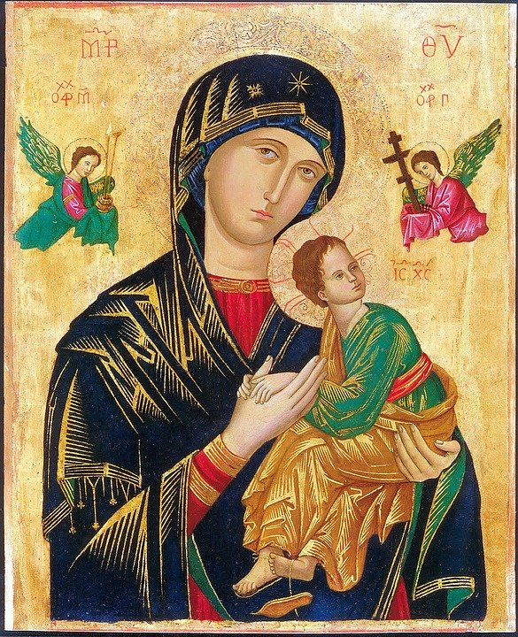
Women in the Bible
There are many notable female characters and heroes across scripture. A few, including Ruth, Esther, and Judith, emerge as especially prominent and even have whole books named after them; but there are others that have only a small appearance in the Bible, some as few as one verse.
Many of the women in the Bible were strong, capable women; they didn’t sit around waiting for someone else to get the job done. They feared God and lived faithfully. They did what they needed to do.
God empowered all women to be strong and follow his call, and he used the actions of these women to inspire and teach us years later through the biblical text.

Slide 3
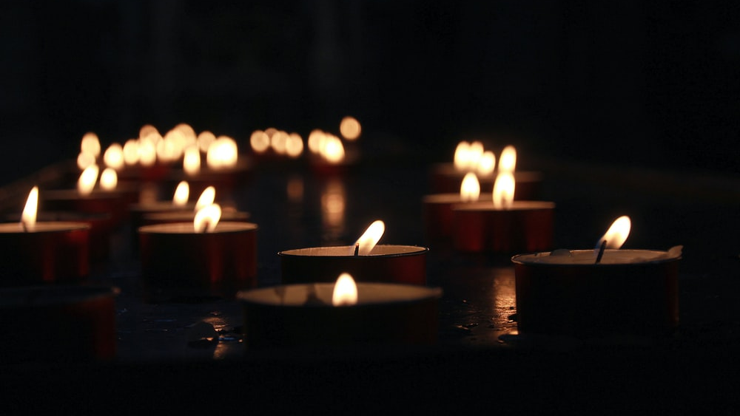
Let us pray

Slide 4
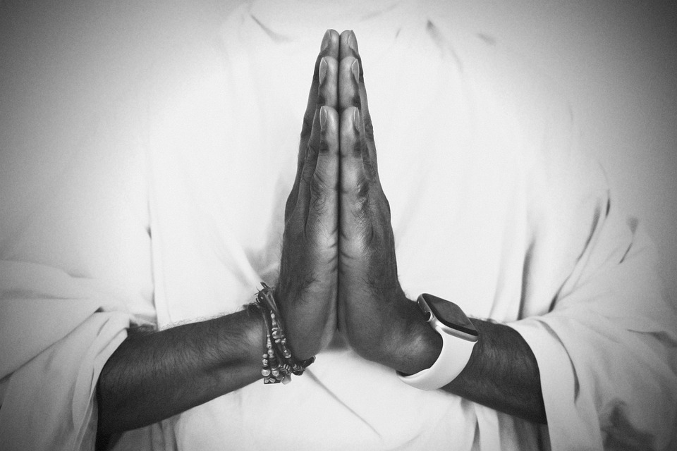
Opening Prayer
Risen Lord, The angel that announced your rising spoke to an audience of but a few women from Galilee.
And then you appeared, risen in the body, but first only to Mary of Magdala.
We look back on all the centuries of your Church.
Born of this small, faithful band, nurtured through the ages so often by the special grace given to women.
Lord, teach us to honour women, in body and in spirit.
For these great disciples have taught us to heal the sick, to feed the poor, to sow mercy and justice and
to make peace.
And we call on them now to pray for us, As we take up the cross ourselves.

Slide 5
Ruth

Slide 6
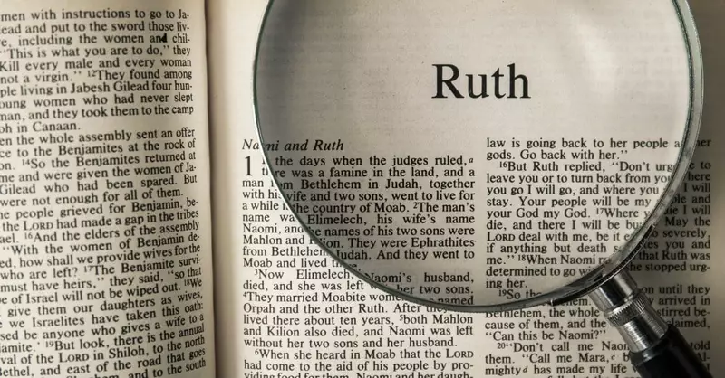
Ruth
Ruth is the central character in the Book of Ruth, which is found in the Old Testament, in the Bible.
There are only two books in the Bible which titles refer to women – the Book of Ruth and the Book of Esther.

Slide 7
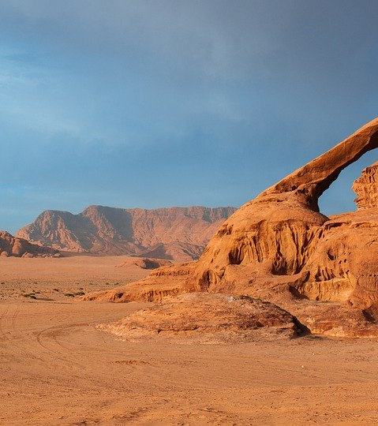
The Story of Ruth
Ruth was not an Israelite; she was from Moab. Moab was an ancient kingdom which today is located in Jordan, in the Middle East.
She married an Israelite but both her husband and her father-in-law died. Instead of returning to Moab, Ruth stayed to help her mother-in-law, Naomi.
The two of them travelled to Bethlehem together, where Ruth won the love of Boaz through her kindness.
She is one of five women mentioned in the family history of Jesus, found in the Gospel of Matthew.

Slide 8
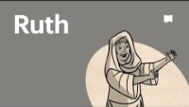
The Story of Ruth

Slide 9
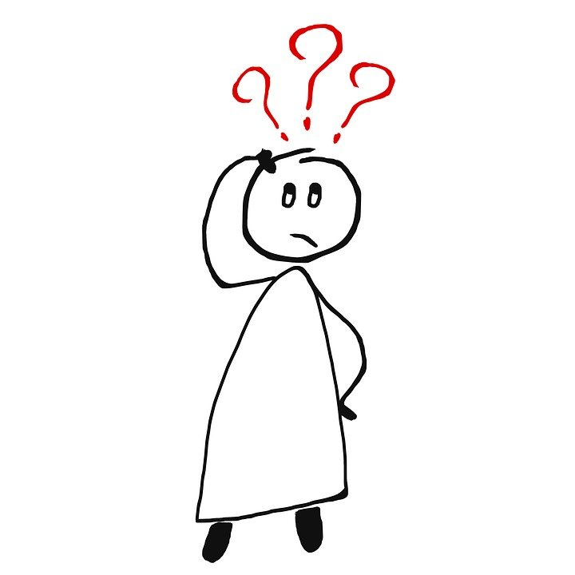
What can we learn from the Book of Ruth?
Naomi was a refugee and Ruth was an immigrant. They were both widows who were poor and isolated, and lived ‘on the margins’ of society.
But it is their story that is contained in the Bible; a story that we can learn a great deal from.
What can we learn from the plight of refugees and immigrants today?
Is it ‘fair’ that their lives are so different to ours, and so difficult?

Slide 10
What can we learn from the Book of Ruth?
Even when things in life are difficult, just like in the lives of Ruth and Naomi, God asks us to be like a ‘light in the dark’ in the way that we treat and help others.
In what way are you letting the light of Christ shine brightly in your life?

Slide 11
Let us pray

Slide 12
Closing Prayer
Father, make us like Ruth - strong and courageous, someone who is full of love and remains close to God.
Make us like Boaz who obeyed God’s law even when it was hard.
Make us like Naomi and help us to remember that God loves us, whatever happens to us.
And may we learn from the Book of Ruth to welcome strangers, stick to our promises, and remain faithful to God and those we are asked to love.
Amen

Slide 13
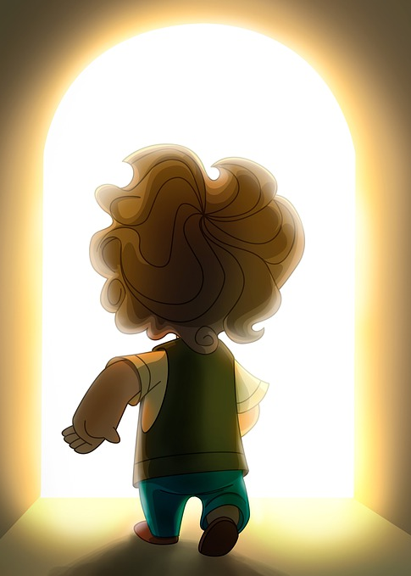
Mission
Imagine what it would be like if you had to suddenly leave your home forever and travel to a different country with only what you could carry; how would you feel?
What do you know about the work that CAFOD and Caritas are doing to support refugees? What can you find out about the marvellous work done by these organisations?
Compose a prayer for people living ‘on the margins’ of society.
Click here for some fabulous activities all about Ruth!

Slide 14
Women in the Bible
Next Week
Esther

