Slide 1
Women in the Bible
Deborah

Slide 2
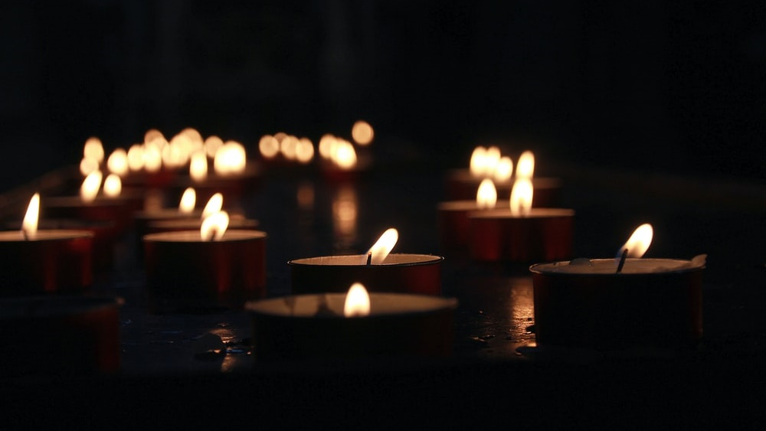
Let us pray

Slide 3
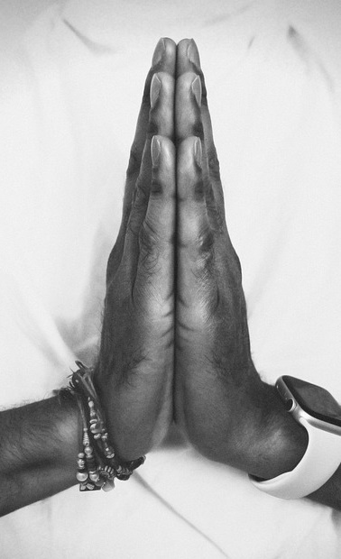
Opening Prayer
Thank you Lord, that you love to do extraordinary things through ordinary people like us.
Release us from what we think are our limitations, that may have kept us from the great plans you have for each person here.
Help us to know how much you love us and that you have a purpose for our lives.
May we ‘wake up and arise’ to be lights for the glory of the Lord!
Amen.

Slide 4
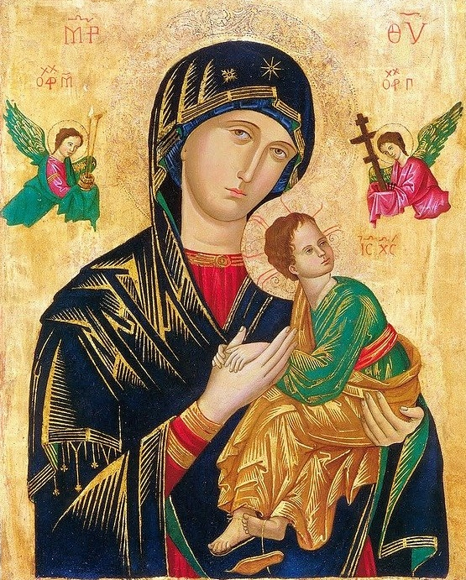
Women in the Bible
There are many notable female characters and heroes across scripture. A few, including Ruth, Esther, and Judith, emerge as especially prominent and even have whole books named after them; but there are others that have only a small appearance in the Bible, some as few as one verse.
Many of the women in the Bible were strong, capable women; they didn’t sit around waiting for someone else to get the job done. They feared God and lived faithfully. They did what they needed to do.
God empowers all women to be strong and follow his call, and he used the actions of these women in the Bible to inspire and teach us years later.

Slide 5
Bible Women Facts!
Women or women's names represent less than 8 percent of the total names in the Bible!
There are 93 women who speak in the Bible, 49 of whom are named!
Abraham's wife Sarah holds the distinction of being the only woman in Scripture where her age at death is recorded. She died at the age of 127! (Genesis 23:1).

Slide 6
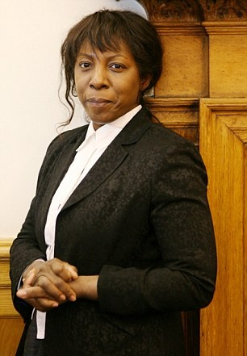
Bible Women Facts!
Deborah was the only woman Judge over ancient Israel (Judges 4:4). She performed this important responsibility for forty years, from 1192 to 1152 B.C.
The book of Esther, written by her and Mordecai, is one of only two Biblical books that do not directly reference God (the other is the Song of Solomon). Esther's book and the one named after Ruth are the only two Biblical writings penned by women.
UK - Judge Constance Briscoe

Slide 7
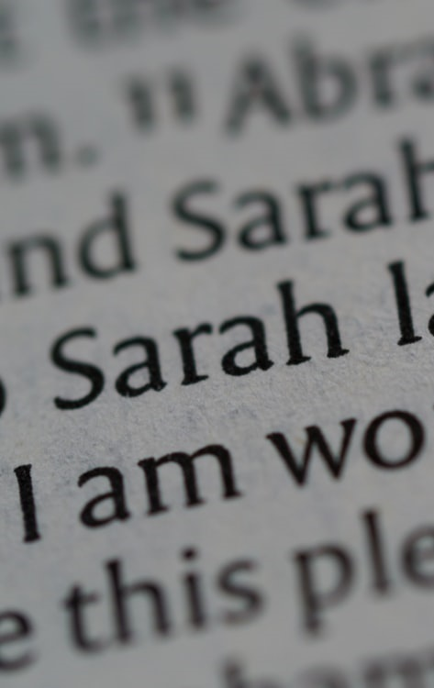
The Most Mentioned Women In The Bible
Old Testament
1. Sarah (41), Sarai (17), Sara (2) = (60 times in total)
Abraham’s wife Sarah, the name she was most commonly called in the Scriptures, is the most mentioned woman in the Bible. Before God changed her name to Sarah, she went by the name of Sarai. Her names are found a total of 60 times in the Bible.
The Rest Of The Top 5 Women
2. Esther (56 times in total)
3. Rachel (47 times in total)
4. Leah (34 times in total)
5. Rebekah (30 times in total)

Slide 8
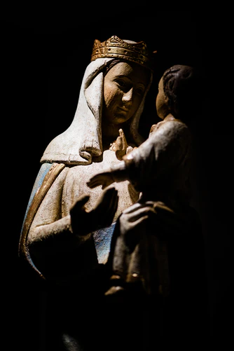
The Most Mentioned Women In The Bible
New Testament
Mary, the mother of Jesus is the most mentioned woman in the New Testament.
In addition to Mary’s name appearing 19 times in the New Testament, she is also referred to a number of other times in the Bible as the mother of Jesus.
Mary Magdalene is mentioned 12 times by name in the New Testament.
In June 2016 she was acknowledged by the Pope as Apostle to the Apostles

Slide 9
Deborah

Slide 10
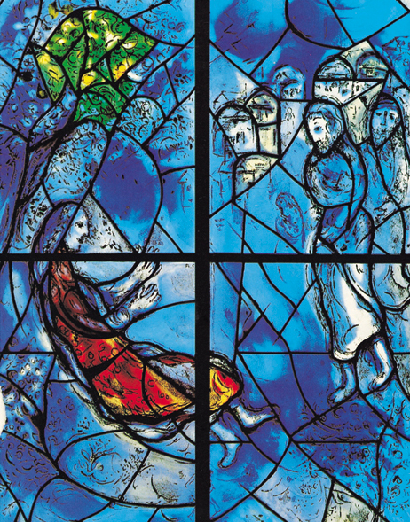
Who is Deborah?
Deborah was a busy woman. She was a prophetess and a judge. In Judges 4:5 says:
“She held court under the Palm of Deborah between Ramah and Bethel in the hill country of Ephraim, and the Israelites went up to her to have their disputes decided.”
Deborah was a woman of great wisdom, revelation, and discernment. She also had a prophetic gift, including knowing the times and seasons of the Lord. She clearly heard the voice of God and used it to guide and lead the Israelites.
Marc Chagall. Photo: © 1997 Artists Rights Society (ARS), NY/ADAGP, Paris.

Slide 11
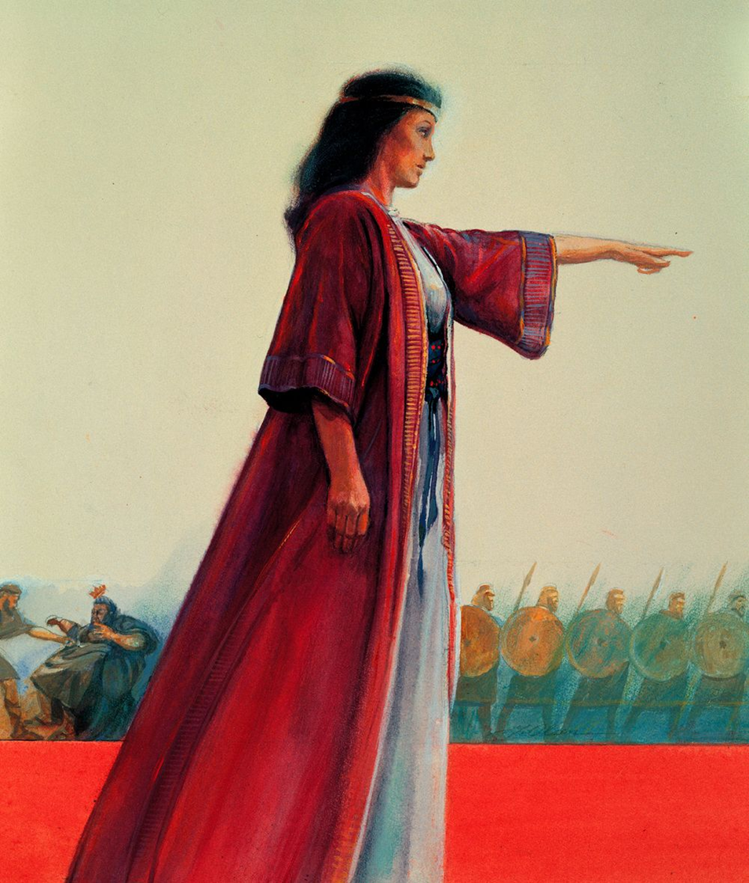
How did Deborah lead?
The story of Deborah in Judges 4 and 5 begins like many of the stories in the Book of Judges - the Israelites sinned against God, and as a result they are being controlled by King Jabin of Canaan.
This went on for 20 years until the Israelites cried out to the Lord for help. At that time, Deborah was leading Israel as a judge. She sent for Barak, a commander in Israel’s army, and told him to go and fight Jabin’s army led by Sisera.
Barak said he would only go if Deborah went with him. Deborah agreed but told Barak the honour will not go to him, because God will deliver Sisera into the hands of a woman.

Slide 12
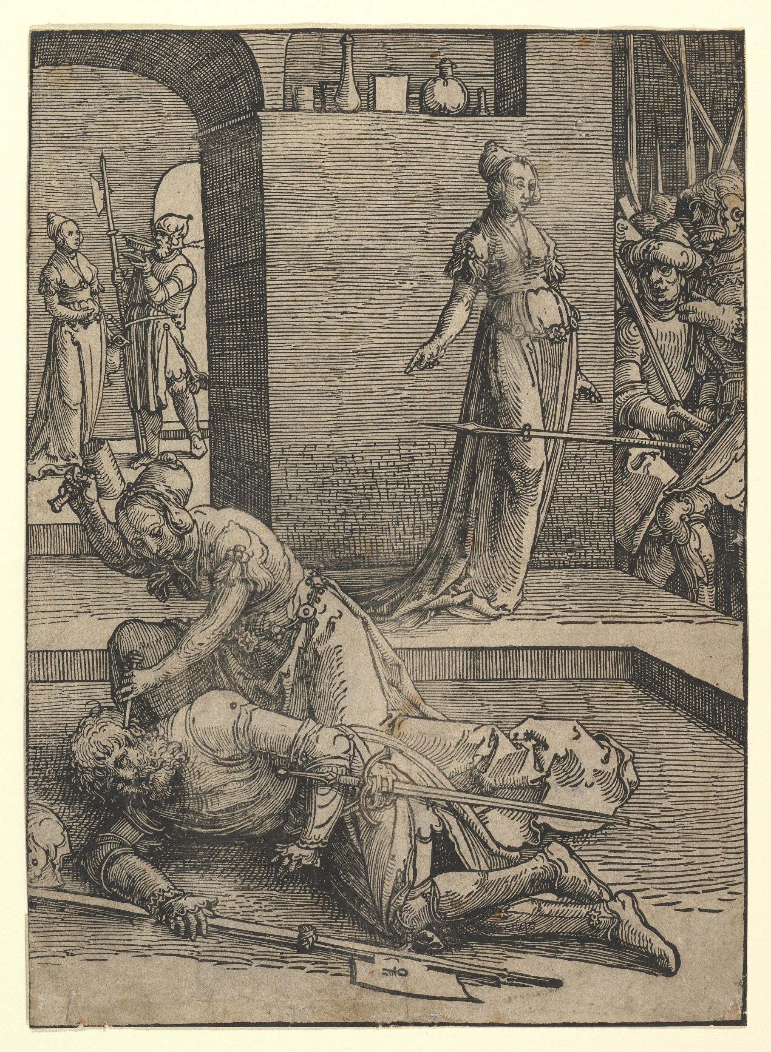
How did Deborah lead?
When Barak’s army advances, they destroyed Sisera’s army, and Sisera flees on foot. Sisera goes to the tent of Jael, the wife of Heber, because there was an alliance between King Jabin and Heber’s family.
Jael invited Sisera in and served him refreshments. Sisera was so exhausted, he fell asleep. Jael then took a hammer and a tent peg and killed Sisera.
Then the Israelites fought against King Jabin until they destroyed him. Afterwards, Deborah and Barak sang a song of praise, and Israel had peace for 40 years.

Slide 13
Watch the Biblical account of Deborah

Slide 14
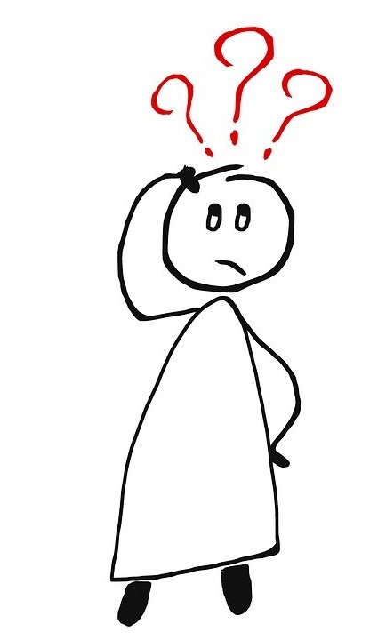
What does this story tell us about Deborah?
In Judges 5:12 it says: “Wake up, wake up, Deborah! Wake up, wake up, break out in song! Arise, Barak! Take captive your captives…”
Deborah needed to “wake up and arise.” The Lord was telling her to be alert and pay attention, as he was about to move in an extraordinary way.
In Judges 5:7 it says: “Villagers in Israel would not fight; they held back until I, Deborah, arose, until I arose, a mother in Israel.” Notice the verse says no one in Israel would fight until Deborah “arose.” The Israelites were beaten down by 20 years of slavery. They were too tired and discouraged to fight. They needed someone to inspire them, and the Lord chose Deborah. If she had not been obedient to act on what the Lord told her to do, nothing would have changed. She used the place of trust and authority she had been given as a judge to inspire Barak to raise up an army.

Slide 15
What does this story tell us about Deborah?
If Deborah had not listened to God and believed he made her for a mighty purpose, she would not have had all the experiences that led to her being used by the Lord to save Israel.
She trusted that God had given her wisdom and revelation to judge disputes. She spent time listening to God and heard the Lord’s strategic battle plans.
She was confident that God had created her for a definite plan and had she not, she would not have directed the Israelites army and brought healing and empowerment to a whole nation.
Deborah’s story would not be complete without acknowledging another woman - Jael. Jael did what she knew she had to do. Deborah called Jael “most blessed of tent-dwelling women” (Judges 5:24). Jael’s actions were invaluable to winning the war.

Slide 16
Let us pray

Slide 17
Closing Prayer
Heavenly Father, thank you for using Deborah and Jael to help deliver your people from oppression.
Use us in the battle against evil and injustice.
Remove the obstacles in our lives that make us doubt our God given potential.
Help us instead to recognise that God has created us to service him and others.
May we be like Deborah and respond with courage to the promptings of the Spirit and the needs of others.
In the name of Your Son we pray.
Amen

Slide 18
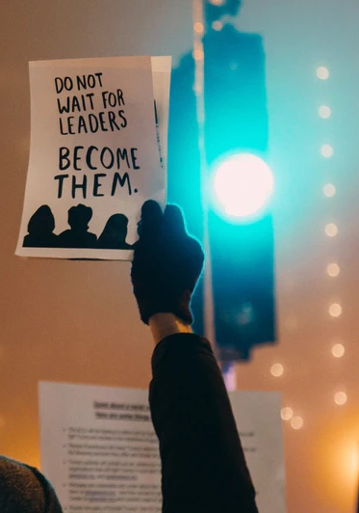
Mission
Deborah ‘woke up and arose’- are you willing to listen to God’s voice and been awakened and willing to stand up to injustices in the world? What injustices make you want to make a difference?
Deborah listen to God and led the Israelite army to victory; are you a leader and are you willing to led people to defeat injustice?
Deborah was bold and courageous. Do you realise you too can do the unique and amazing things God is calling you to do. Wherever the Lord has placed you, will you accept the challenge to be a light in the darkness for the Kingdom of God?
Will you encourage others to do it, too?

Slide 19
Women in the Bible
Next Week:
Jehosheba

