Slide 1
Women in the Bible
Jehosheba

Slide 2
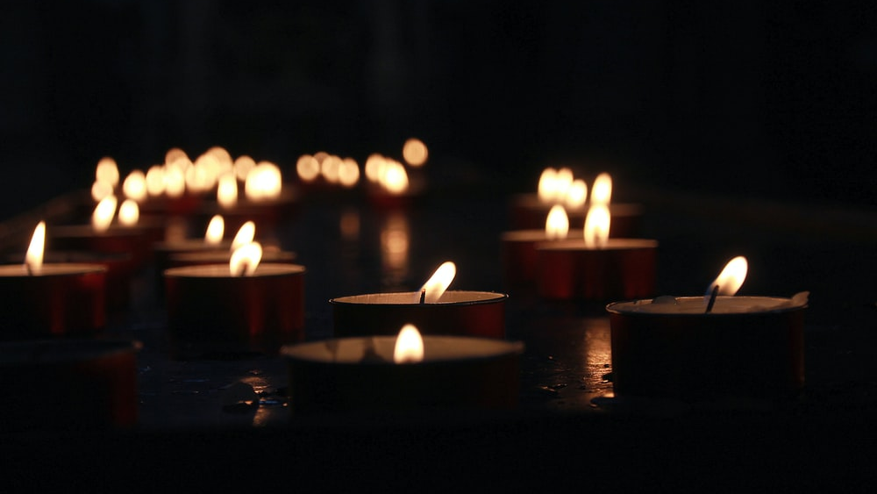
Let us pray

Slide 3
Opening Prayer
Risen Lord, The angel that announced your rising spoke to an audience of but a few women from Galilee.
And then you appeared, risen in the body, but first only to Mary of Magdala.
We look back on all the centuries of your Church.
Born of this small, faithful band, nurtured through the ages so often by the special grace given to women.
Lord, teach us to honour women, in body and in spirit.
For these great disciples have taught us to heal the sick, to feed the poor, to sow mercy and justice and
to make peace.
And we call on them now to pray for us, As we take up the cross ourselves.

Slide 4
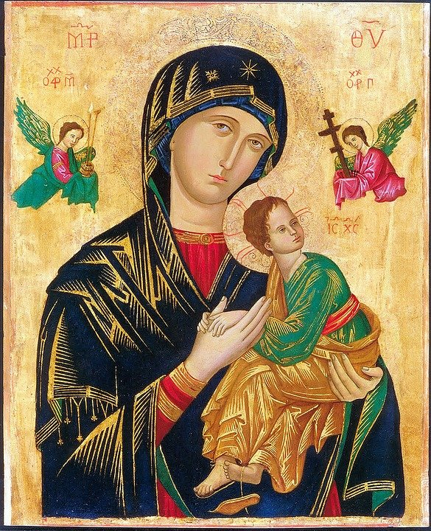
Women in the Bible
There are many notable female characters and heroes across scripture. A few, including Ruth, Esther, and Judith, emerge as especially prominent and even have whole books named after them; but there are others that have only a small appearance in the Bible, some as few as one verse.
Many of the women in the Bible were strong, capable women; they didn’t sit around waiting for someone else to get the job done. They feared God and lived faithfully. They did what they needed to do.
God empowered all women to be strong and follow his call, and he used the actions of these women to inspire and teach us years later through the biblical text.

Slide 5
Bible Women Facts!
Women or women's names represent less than 8 percent of the total names in the Bible!
There are 93 women who speak in the Bible, 49 of whom are named!
Abraham's wife Sarah holds the distinction of being the only woman in Scripture where her age at death is recorded. She died at the age of 127 (Genesis 23:1).

Slide 6
Bible Women Facts!
Deborah was the only woman Judge over ancient Israel (Judges 4:4). She performed this important responsibility for forty years, from 1192 to 1152 B.C.
The book of Esther, written by her and Mordecai, is one of only two Biblical books that do not directly reference God (the other is the Song of Solomon). Esther's book and the one named after Ruth are the only two Biblical writings penned by women.

Slide 7
The Most Mentioned Women In The Bible
Old Testament
1. Sarah (41), Sarai (17), Sara (2) = (60 times in total)
Abraham’s wife Sarah, the name she was most commonly called in the Scriptures, is the most mentioned woman in the Bible. Before God changed her name to Sarah, she went by the name of Sarai. Her names are found a total of 60 times in the Bible.
The Rest Of The Top 5 Women
2. Esther (56 times in total)
3. Rachel (47 times in total)
4. Leah (34 times in total)
5. Rebekah (30 times in total)

Slide 8
The Most Mentioned Women In The Bible
New Testament
Mary, the mother of Jesus is the most mentioned woman in the New Testament.
In addition to Mary’s name appearing 19 times in the New Testament, she is also referred to a number of other times in the Bible as the mother of Jesus.
Mary Magdalene is mentioned 12 times by name in the New Testament.
In June 2016 she was acknowledged by the Pope as Apostle to the Apostles

Slide 9
Jehosheba
‘Jehovah Is Her Oath’

Slide 10
Jehosheba
Jehosheba was the daughter of King Jehoram.
She became the wife of the high priest, Jehoiada, and is the only instance of a princess marrying a high priest.
She was a very courageous woman who stole her nephew, Joash, from among the bodies of the king’s sons and hid him for six years from Athaliah. By doing this, Jehosheba preserved ‘The Seed Royal’, because if Joash had died, the line of Judah would have been extinct.

Slide 11
The Story Behind Jehosheba’s Story!

Slide 12
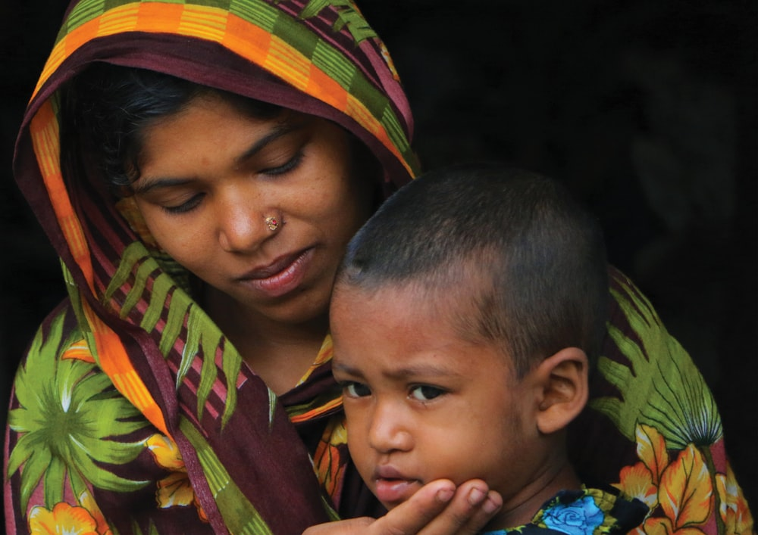
2 Kings 11: 2 - 3
‘But Jehosheba, the daughter of King Jehoram and sister of Ahaziah, took Joash son of Ahaziah and stole him away from among the royal princes, who were about to be murdered.
She put him and his nurse in a bedroom to hide him from Athaliah; so he was not killed. He remained hidden with his nurse at the temple of the Lord for six years while Athaliah ruled the land.’

Slide 13
What does this story tell us about Jehosheba?
From this incredible story, we can see that Jehosheba was very brave and courageous.
Do we think she regretted not being able to save more of the royal children?
What if Joash had cried and the soldiers had heard;
What if they’d got caught?
Jehosheba kept Joash a secret for six years ; what does this tell you about Jehosheba?
Can you think of a new Testament character who risked his reputation, his dignity, even his life to protect a mother and her child?

Slide 14
Let us pray

Slide 15
Closing Prayer
Almighty father in heaven, we ask for your strong arms of protection to be around all children.
May the example of Johosheba, who rescued her nephew Joash without any thought for her own safety, provide inspiration and courage for all, particularly, those who care for children.
May all children of the world be held safely within your love.
Fill their days and nights with hope and joy;
Fill their hearts and minds with you truth and light through the example of those around them.
We trust in you. Amen

Slide 16
Mission
Jehosheba’s courage saved her nephew and ultimately her faith; how can you follow Jehosheba’s example in your daily life?
Can you find out more about various organisations that work to save and protect children at a local, national and global level (ie: The Catholic Children’s Society; CAFOD; Save The Children ?)
Compose/Say a prayer for those children around the world who are the innocent victims of conflict and war.

Slide 17
Women in the Bible
Next Week:
Ruth

