Slide 1

Women in the Bible
Esther
‘Star’

Slide 2
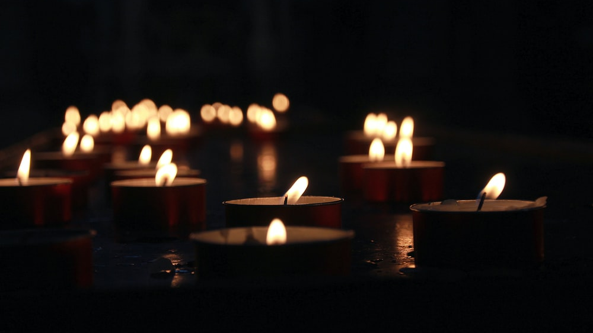
Let us pray

Slide 3

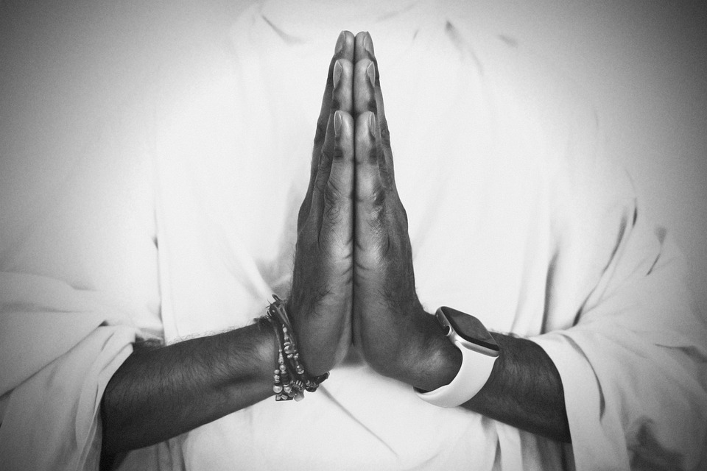
Opening Prayer
Risen Lord, The angel that announced your rising spoke to an audience of but a few women from Galilee.
And then you appeared, risen in the body, but first only to Mary of Magdala.
We look back on all the centuries of your Church;
born of this small, faithful band, nurtured through the ages so often by the special grace given to women.
Lord, teach us to honour women, in body and in spirit.
For these great disciples have taught us to heal the sick, to feed the poor, to sow mercy and justice and
to make peace.
And we call on them now to pray for us, As we take up the cross ourselves.

Slide 4
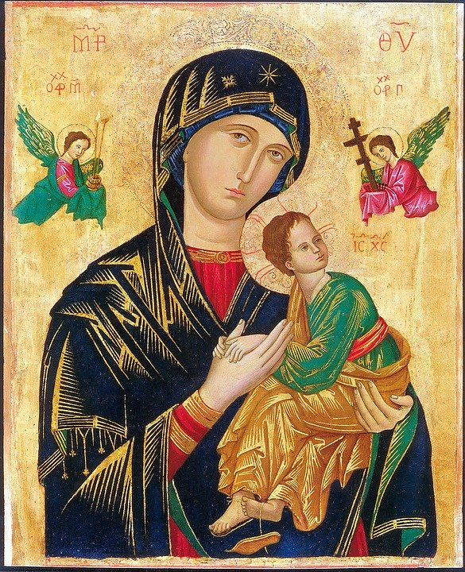
Women in the Bible
There are many notable female characters and heroes across scripture. A few, including Ruth, Esther, and Judith, emerge as especially prominent and even have whole books named after them; but there are others that have only a small appearance in the Bible, some as few as one verse.
Many of the women in the Bible were strong, capable women; they didn’t sit around waiting for someone else to get the job done. They feared God and lived faithfully. They did what they needed to do.
God empowered all women to be strong and follow his call, and he used the actions of these women to inspire and teach us years later through the biblical text.

Slide 5
Esther

Slide 6
The Book of Esther
Though God is never mentioned in the book of Esther, we can see clearly that he is at work behind the scenes.
Reading Esther reminds us that even when it seems like God is absent, he is still at work in our lives and will not abandon his promises.
Esther's drama deals with power, money, intrigue, hatred and murder. It includes a beauty pageant, a royal household and a deadly rivalry.

Slide 7
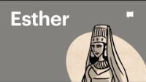
The Book of Esther

Slide 8

The Book of Esther (Hebrew: מְגִלַּת אֶסְתֵּר‎,, also known in Hebrew as ‘the Scroll’ (Megillah), is a book in the third section (Ketuvim, כְּתוּבִים‎ 'Writings’) of the Jewish Tanakh (the Hebrew Bible). It is one of the five Scrolls (Megillot) in the Hebrew Bible and later became part of the Christian Greek Old Testament.

Slide 9
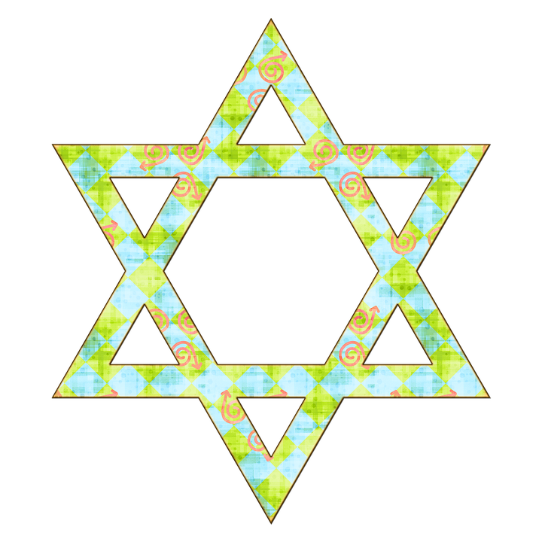
The book relates the story of a Hebrew woman in Persia, born as Hadassah but known as Esther, who becomes queen of Persia and stops her people being killed.
The story forms the core of the Jewish festival of Purim, during which it is read aloud twice: once in the evening and again the following morning.

Slide 10
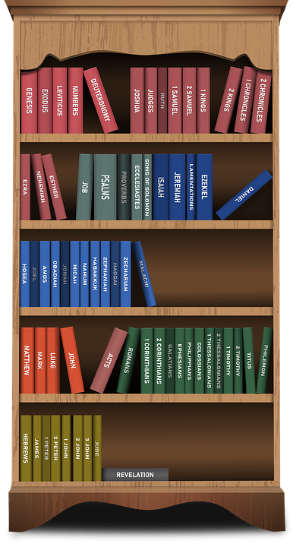
Esther, as queen, is the only Jew in a position high enough to try and help her people; but even she must risk her life to do so because of a Persian custom meaning that everyone who makes an uninvited visit to the king's court will be killed.

Slide 11
By uncovering the wicked court official Haman’s plot to execute her uncle Mordecai for his failure to bow down to Haman, she also makes known his scheme to destroy all the Jews in Persia.
In doing so, she not only saves her people but preserves their right to worship Yahweh alone.

Slide 12
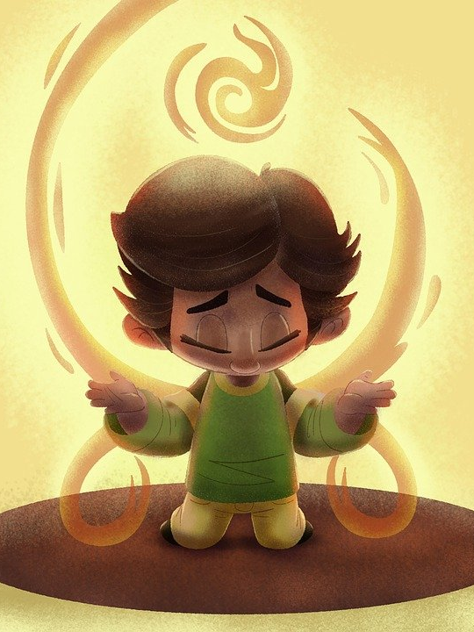
God is never absent!
Esther's willingness to risk her life for God's people is greatly rewarded because her people are saved and their enemies are defeated.
The characters in the Book of Esther and their struggles teach us that God's mysterious hand is at work for those who love him, even in the most difficult circumstances.

Slide 13
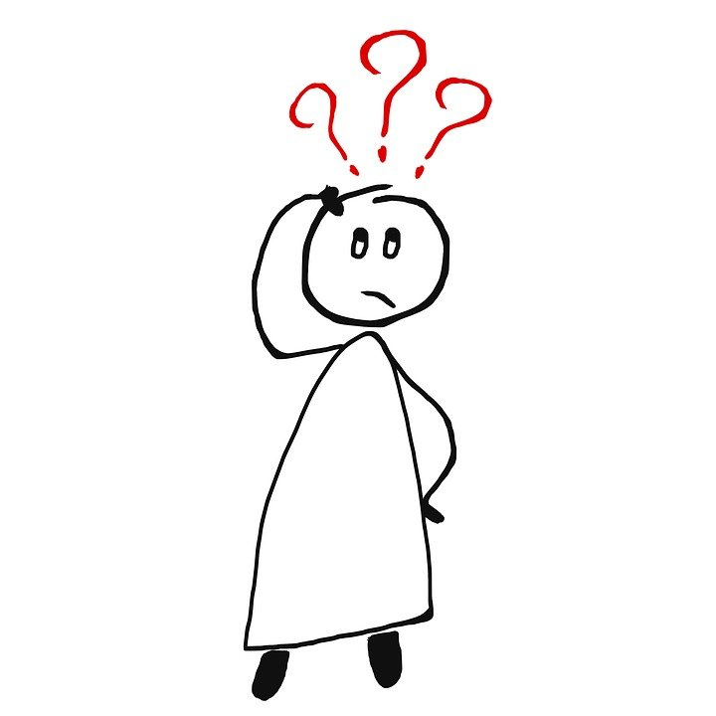
What do we learn from the Book of Esther and her life?
God has a purpose for our lives, and we should be willing to trust and follow God’s plans.
We must be willing to rise up when God places us in a position of influence and use every opportunity to promote God and protect His people. He has a plan for our lives.

Slide 14
We should not remain silent when anyone threatens the safety of other people, especially God’s people.
Fasting and prayer is important.
Be courageous and willing to sacrifice your life to help others.
Do not seek recognition; let God choose how to honour you.
Trust and obey God in spite of any circumstances.

Slide 15
Let us pray

Slide 16
Closing Prayer
Trust in God
Lord, You are the God of peace and love in whom I place my trust, just like Esther did.
Give me a peaceful heart that rests in You and a loving spirit that pours fourth your love to others.
Lord, you are the God of comfort and rest in whom I put my hope.

Slide 17
Give me a heart that lives in you so that your comfort may stream through me to others who need comfort and strength.
Lord, You are the God of hope and joy in whom I stand secure.
Give me a spirit of devotion that worships only you so that I may be a worthy witness that points to Jesus, for in him is all goodness.
I place my trust in You, Lord.
Amen.

Slide 18
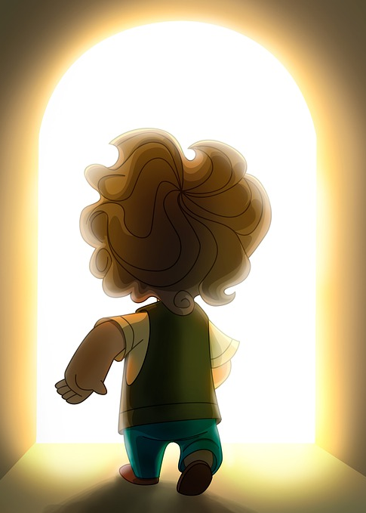
Mission
Esther believed in the power of prayer and in standing up for those in need. Try to remember those people in the world who may need your prayers at the moment.
Esther put all of her trust in God; how can you show God that you trust him and the plans that he has for you?
During the festival of Purim, the Book of Esther is read twice; can you find out more about this special day in the Jewish calendar?

Slide 19
Women in the Bible
Next Week:
Anna

