Slide 1

Women in the Bible
Mary
‘Our Lady’

Slide 2
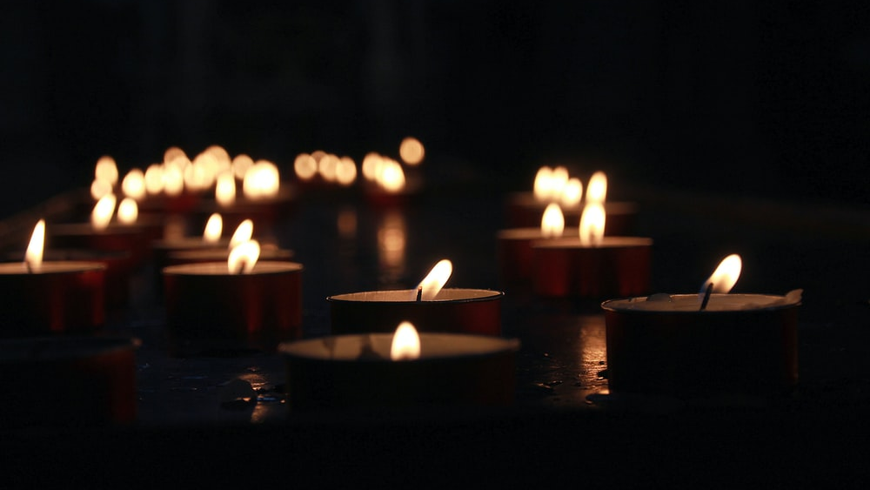
Let us pray

Slide 3


Opening Prayer
Hail Mary,
Full of grace,
The Lord is with thee.
Blessed art thou among women,
and blessed is the fruit of thy womb, Jesus.
Holy Mary, Mother of God,
pray for us sinners now,
and at the hour of our death.
Amen

Slide 4
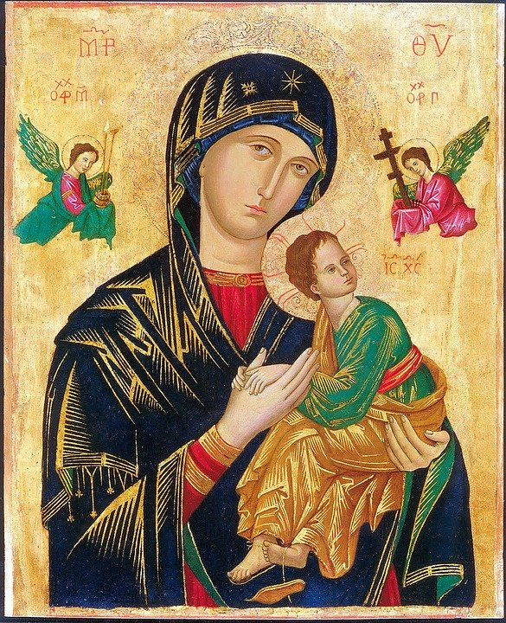
Women in the Bible
There are many notable female characters and heroes across scripture. A few, including Ruth, Esther, and Judith, emerge as especially prominent and even have whole books named after them; but there are others that have only a small appearance in the Bible, some as few as one verse.
Many of the women in the Bible were strong, capable women; they didn’t sit around waiting for someone else to get the job done. They feared God and lived faithfully. They did what they needed to do.
God empowered all women to be strong and follow his call, and he used the actions of these women to inspire and teach us years later through the biblical text.

Slide 5
Mary

Slide 6
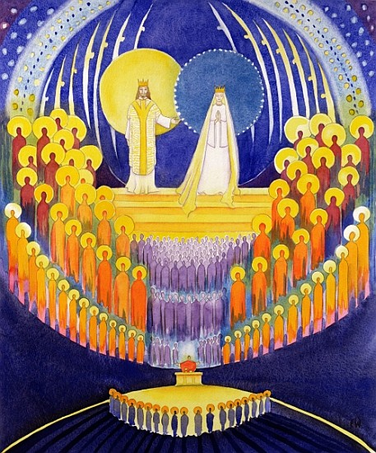
The Greatest Of All Saints
Mary is considered by many to be the greatest of all saints because she was chosen and prepared by God to be the mother of His Son, and because she freely chose to cooperate fully in the graces given to her and in the vocation she received.
Notes:
.
Look carefully to see which one is Jesus – the one with the thorns.

Slide 7
In Mary’s Song of Praise (The Magnificat), she says, ‘My soul magnifies the Lord, and my spirit rejoices in God my Saviour, for he has looked on the humble estate of his servant. For behold, from now on all generations will call me blessed; for he who is mighty had done great things for me, and holy is his name.’
(Luke 1:46-49).
Notes:
.
Look carefully to see which one is Jesus – the one with the thorns.

Slide 8
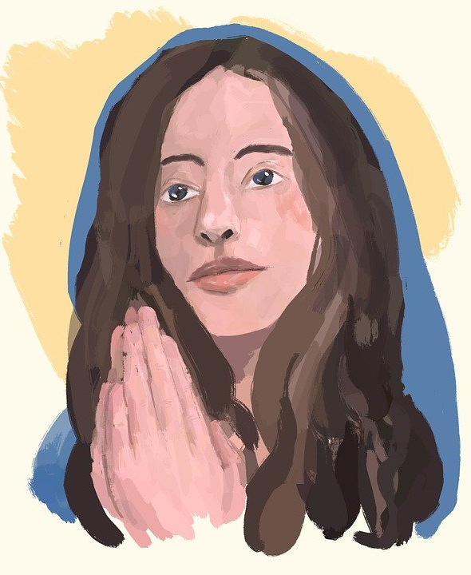
Mary is one of the most admired figures in Scripture.
She was a willing servant who trusted God and obeyed his call.
While her life held great honour, her calling also required great suffering.

Slide 9
Though there was joy in motherhood, there was great pain in the privilege of being the mother of the Messiah.
Despite these things, she responded to God with great obedience and submission to his plan.
Her life never robbed Jesus of his glory, for her mission was to witness the glory of the Son of God.

Slide 10
As befitting the Mother of God and Queen on Heaven, Mary has numerous titles and names.
How else could we grasp the aspects of Our Lady merely by her given name?
And strange but true…the Gospel of John doesn't even name Mary, only referring to her as the mother of Jesus!
Notes:
.
Look carefully to see which one is Jesus – the one with the thorns.

Slide 11
Alternative ‘Titles’ for Mary
Blessed Virgin Mary: This refers to the fact that Mary is ever-virgin — before, during and after the birth of Jesus.
Mother of God: Officially given to Mary at the Council of Ephesus in 431 under the Greek term of Theotokos (one who bears the One who is God), this title recognizes that her son Jesus is both fully God and fully man.
Notes:
.
Look carefully to see which one is Jesus – the one with the thorns.

Slide 12
Our Lady: A title deriving from courtly honours, often used for noble women and queens, it appears in many languages.
Queen of Heaven: As the mother of Jesus, Mary takes her place by his side as queen and is addressed as such.
Immaculate Conception: This title recognizes that Mary was conceived without original sin.
The Assumption: Refers to the fact that Mary was bodily taken up (assumed) into heaven after her death.
Notes:
.
Look carefully to see which one is Jesus – the one with the thorns.

Slide 13
Mary loved God and wanted to serve him with all her heart. But she was just a poor girl in an insignificant town, from a humble family, with little expectations that her life going to be any different than most.
When the angel Gabriel came to Mary to tell her she was chosen and favoured by God to be the mother of his son, despite her own fear, she exhibited great courage and character: ‘I am the Lord’s servant…May your word to me be fulfilled.’ (Luke 1:38).
Notes:
.
Look carefully to see which one is Jesus – the one with the thorns.

Slide 14
She also exhibited great courage and character during Jesus’ earthly life and ministry. She pressed Jesus to provide wine when it ran low at the wedding in Cana, she approached Jesus when he was left behind at the temple, she went from Nazareth to Capernaum when she learned what was being reported their about Jesus, and she attempts to protect Jesus in some of the stickiest of situations. She was a person of discipleship and faith, and the first true follower of Jesus.
Notes:
.
Look carefully to see which one is Jesus – the one with the thorns.

Slide 15
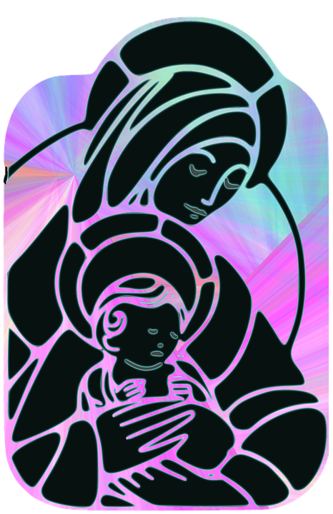
Instrumental in Jesus’ Life
The first recorded miracle of Jesus was performed at a wedding in Cana. In John 2:1-2, we are told, “When the wine ran out, the mother of Jesus said to Him, ‘They have no wine.’ And Jesus said to her, ‘Woman, what does this have to do with me? My hour has not yet come.’
Notes:
.
Look carefully to see which one is Jesus – the one with the thorns.

Slide 16
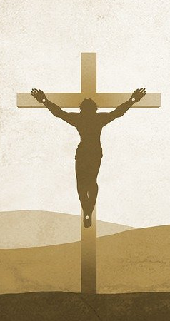
His mother said to the servants. ‘Do whatever he tells you.’”
Mary was instrumental in calling Jesus’ attention to the need and these verses remind us of Jesus’ true purpose.
She was also present at the Crucifixion in Jerusalem. There, she was given into John the Apostle’s care. She was also present with the disciples in the days before the Pentecost. It is also believed that she was present at the resurrection and Ascension.
Notes:
.
Look carefully to see which one is Jesus – the one with the thorns.

Slide 17
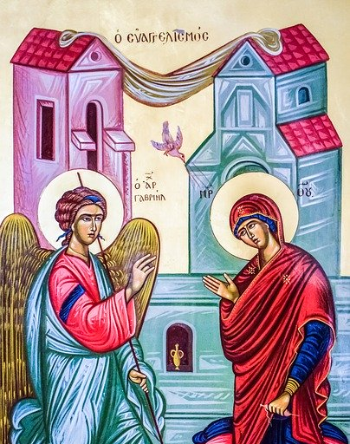
The Annunciation
In the sixth month of Elizabeth’s pregnancy, God sent the angel Gabriel to Nazareth, a town in Galilee, to a virgin pledged to be married to a man named Joseph, a descendant of David. The virgin’s name was Mary. The angel went to her and said, “Greetings, you who are highly favoured! The Lord is with you.”

Slide 18
Mary was greatly troubled at his words and wondered what kind of greeting this might be. But the angel said to her, “Do not be afraid, Mary; you have found favour with God. You will conceive and give birth to a son, and you are to call him Jesus. He will be great and will be called the Son of the Most High. The Lord God will give him the throne of his father David, and he will reign over Jacob’s descendants forever; his kingdom will never end.” “How will this be,” Mary asked the angel, “since I am a virgin?”

Slide 19
The angel answered, “The Holy Spirit will come on you, and the power of the Most High will overshadow you. So the holy one to be born will be called the Son of God. Even Elizabeth your relative is going to have a child in her old age, and she who was said to be unable to conceive is in her sixth month. For no word from God will ever fail.”
“I am the Lord’s servant,” Mary answered. “May your word to me be fulfilled.” Then the angel left her.
Luke 1:26-38

Slide 20
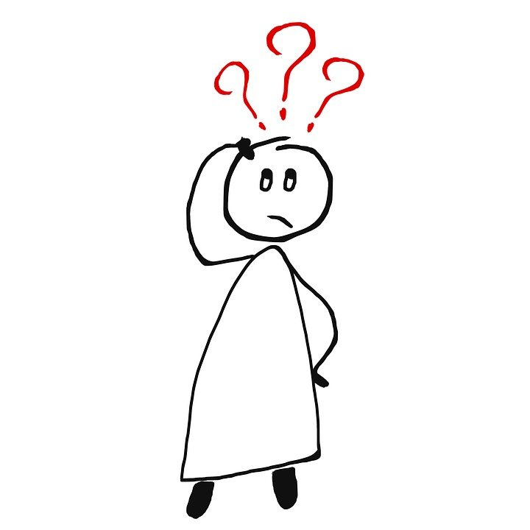
What do we learn from Mary?
Mary said “yes” to God's plan for her life, showing her complete belief and trust in him.
Mary was a faithful servant. When it seemed like everyone had deserted Jesus, his mother Mary was there, and she followed him all the way to the cross.

Slide 21
It’s OK to be afraid at first; when Mary was greeted by the angel Gabriel she was struck with fear, but overcame her fear to do God’s will.
Be humble, but recognise your talents and use them for the good of others.
It is important to think of the needs of others and do what you can to help those in need, despite your own needs.

Slide 22
Let us pray

Slide 23
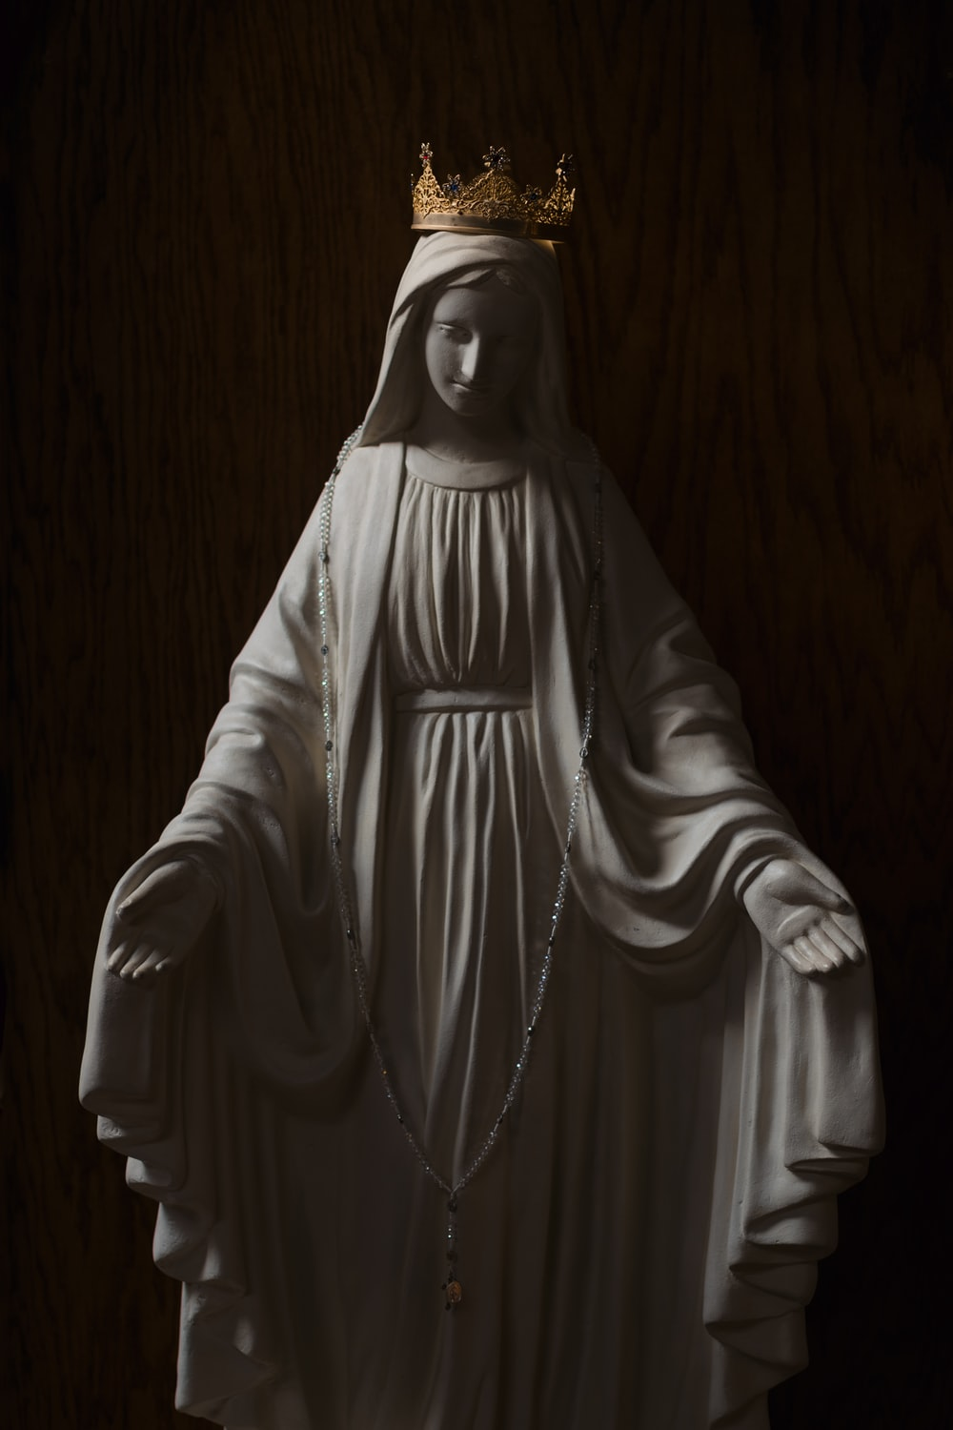
Closing Prayer
Hail Holy Queen
Hail, holy Queen, Mother of mercy, hail, our life, our sweetness and our hope.
To thee do we cry, poor banished children of Eve: to thee do we send up our sighs, mourning and weeping in this vale of tears.

Slide 24
Turn then, most gracious advocate, thine eyes of mercy toward us, and after this our exile, show unto us the blessed fruit of thy womb, Jesus.
O merciful, O loving,
O sweet Virgin Mary!
Amen.

Slide 25
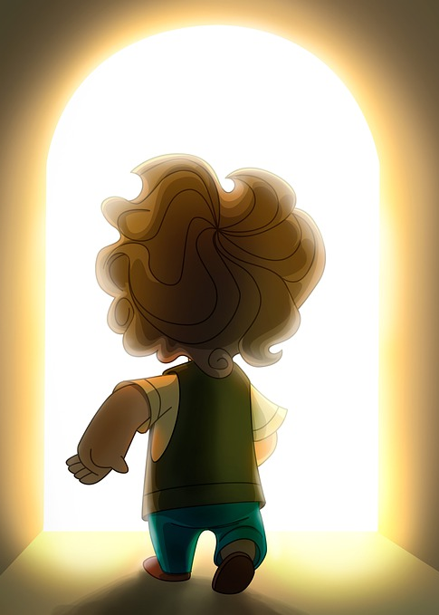
Mission
Apart from her actual name, Mary has many ‘titles’; can you think of any others that could be used based on her life?
Mary was a great believer in the power of prayer. Can you create your own personal prayer to Our Lady?
What is your favourite story about Mary in the Bible? Why have you chosen this story? What would you tell somebody else that it ‘teaches’ you?

Slide 26
Women in the Bible
Next Week:
Mary of Bethany

