Slide 1

Women in the Bible
Mary of Bethany

Slide 2
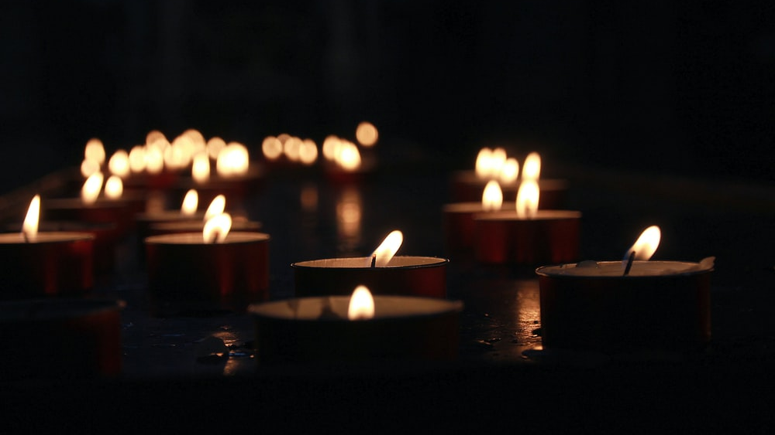
Let us pray

Slide 3

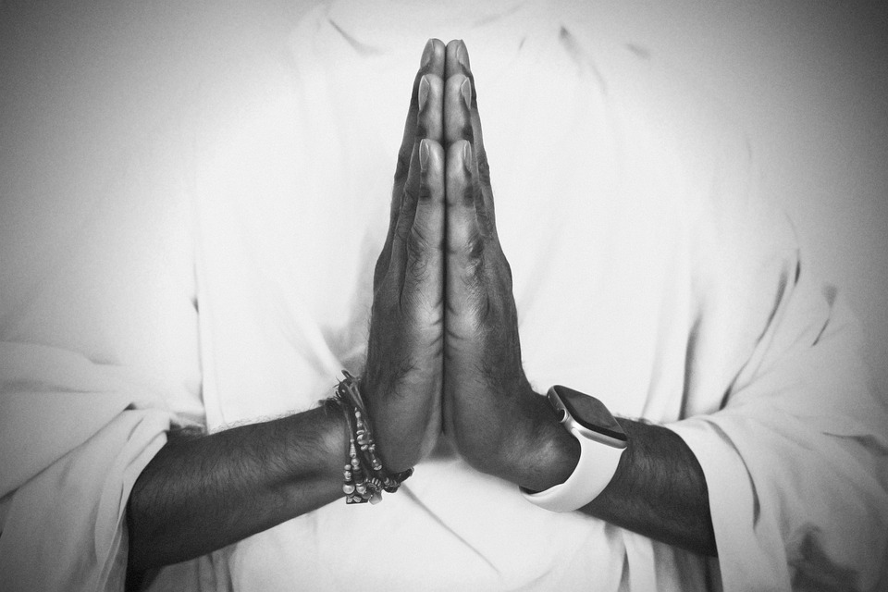
Opening Prayer
Risen Lord, The angel that announced your rising spoke to an audience of but a few women from Galilee.
And then you appeared, risen in the body, but first only to Mary of Magdala.
We look back on all the centuries of your Church.
Born of this small, faithful band, nurtured through the ages so often by the special grace given to women.
Lord, teach us to honour women, in body and in spirit.
For these great disciples have taught us to heal the sick, to feed the poor, to sow mercy and justice and
to make peace.
And we call on them now to pray for us, As we take up the cross ourselves.

Slide 4
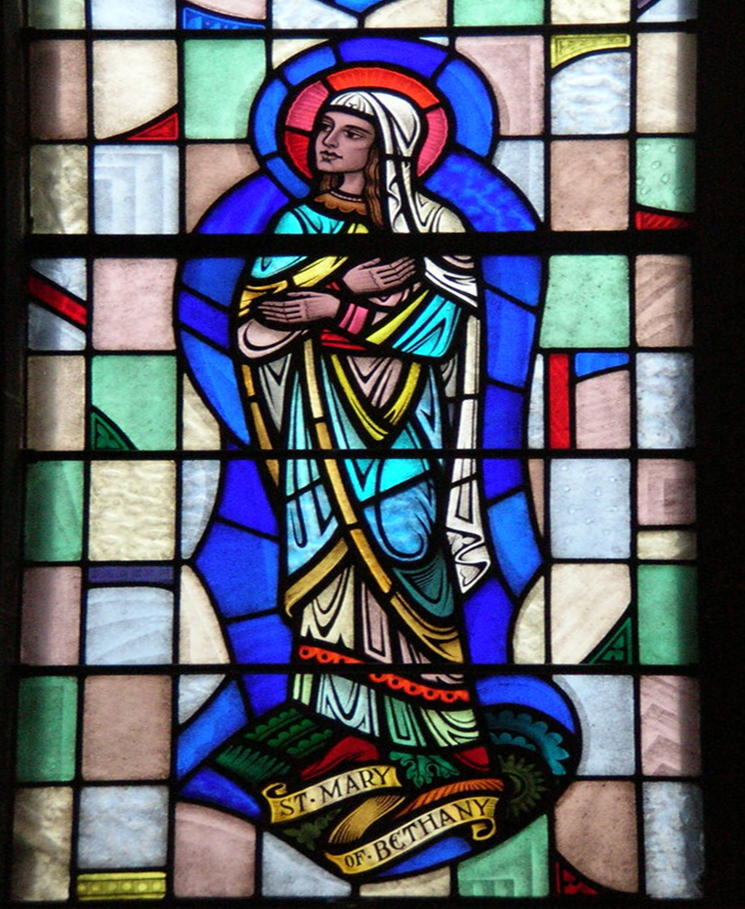
Mary of Bethany
Mary of Bethany is mentioned three times in the New Testament and we learn from these accounts that she had a sister called Martha and a brother called Lazarus.
Bethany is where Mary was from and was a small village in Judaea to the south of the Mount of Olives near Jerusalem. This title is used so she is not confused with the other Marys in the New Testament.

Slide 5
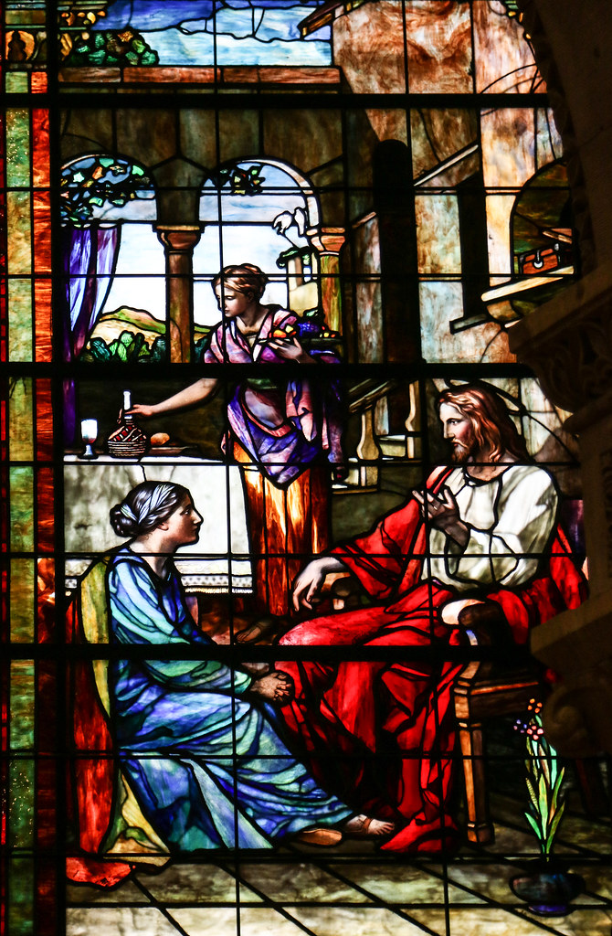
First Account:
Jesus visits Mary and Martha
‘Now as they went on their way, he entered a certain village, where a woman named Martha welcomed him into her home. She had a sister named Mary, who sat at the Lord’s feet and listened to what he was saying. But Martha was distracted by her many tasks; so she came to him and asked, “Lord, do you not care that my sister has left me to do all the work by myself? Tell her then to help me.” But the Lord answered her, “Martha, Martha, you are worried and distracted by many things; there is need of only one thing. Mary has chosen the better part, which will not be taken away from her.”
(Luke 10:38-42)

Slide 6
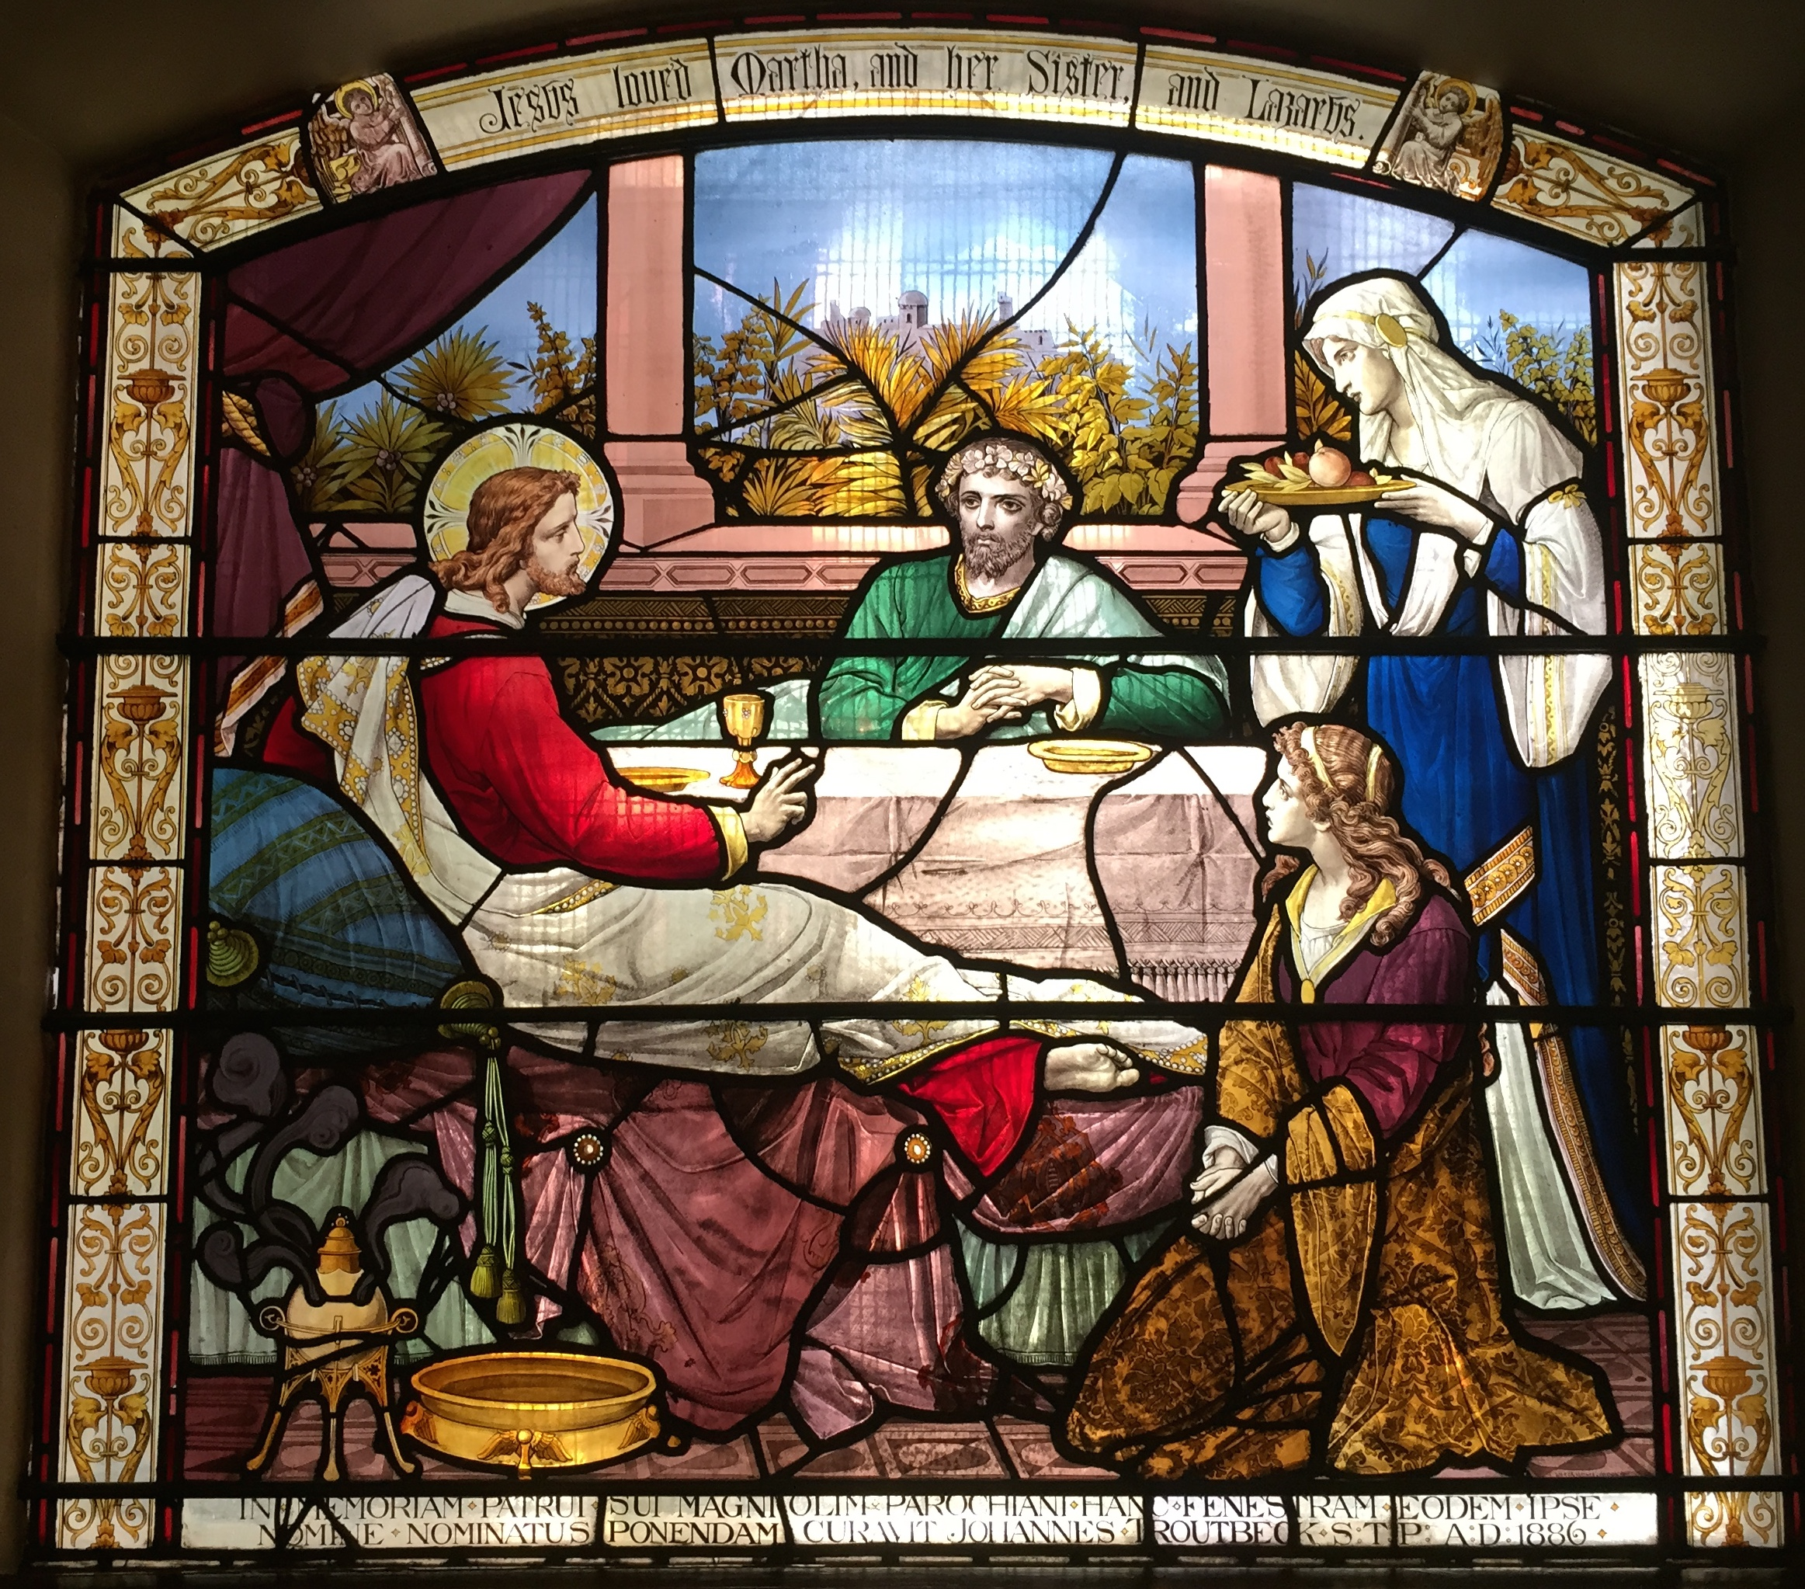
Mary of Bethany
From the account of Jesus visiting Mary and Martha (Luke 10:38-42) we learn that Mary of Bethany wanted to learn and was focused solely on Jesus’s words rather then what her sister Martha was doing, which was seen as women’s work.

Slide 7
For a women to sit at Jesus' feet, and for him to allow her to do so, was itself controversial. By doing this Mary becomes a disciple as she was ‘sitting at the feet of the teacher’. It was unusual for a woman at this time to be accepted by a teacher as a disciple but Jesus welcomed Mary of Bethany and spent time teaching and talking to her, much to the frustration of her sister! However, when Martha complains Jesus says – “…there is need of only one thing. Mary has chosen the better part, which will not be taken away from her.”

Slide 8
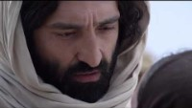
Mary of Bethany – Second Account
Raising of Lazarus (John 11:1- 44)

Slide 9
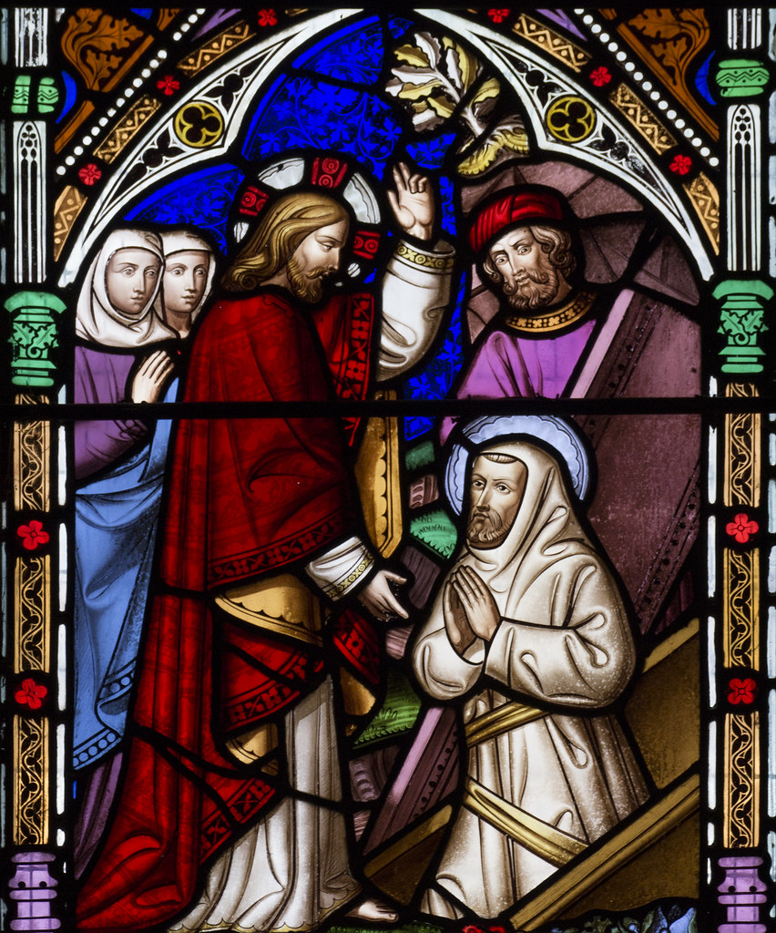
Mary of Bethany
From the account of Jesus raising Lazarus from the dead (John 11:1-44) we find out that Mary of Bethany was good friends with Jesus and had faith in him. The sisters send for Jesus when their brother is ill and when Jesus calls to her, Mary goes to him. She is honest about her frustration with Jesus when she says “Lord, if you had been here, my brother would not have died.”
From this second account we learn that Mary was a follower of Jesus and that she had great faith in his power to heal.

Slide 10
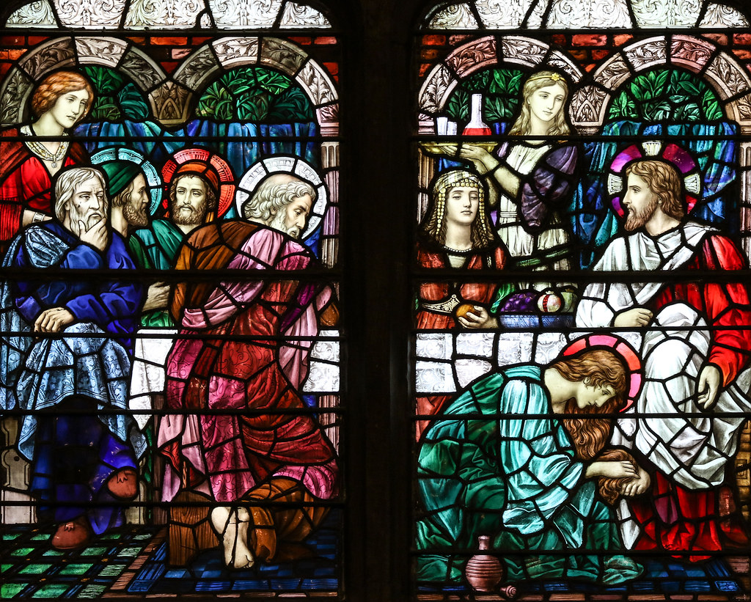
Third Account
Mary Anoints Jesus
‘Six days before the Passover Jesus came to Bethany, the home of Lazarus, whom he had raised from the dead. There they gave a dinner for him. Martha served, and Lazarus was one of those at the table with him. Mary took a pound of costly perfume made of pure nard, anointed Jesus’ feet, and wiped them with her hair. The house was filled with the fragrance of the perfume.’
(John 12:1-3)

Slide 11
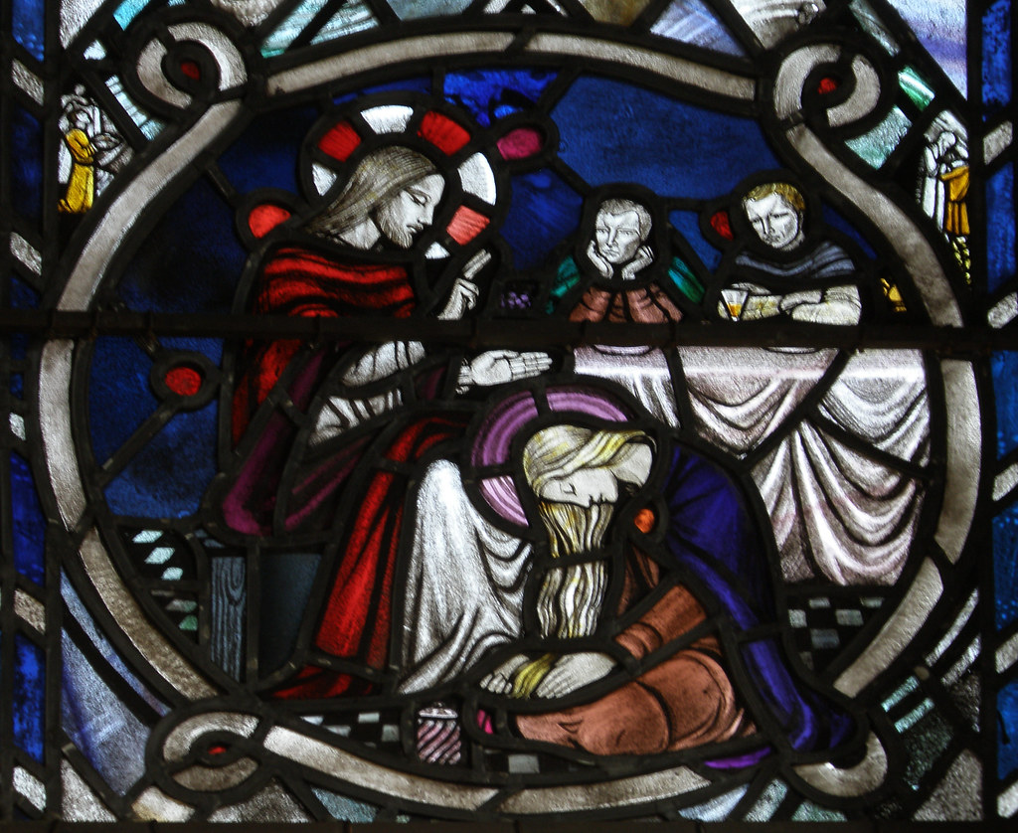
Mary of Bethany
From the third account of Mary of Bethany we can see how her great love and devotion to Jesus has grown.
It was common for visitors to have their feet washed in Jesus’ time as it was a hot and dusty. However, Mary of Bethany showed her great respect and adoration for Jesus but using very expensive oil (it cost a whole year’s wage!) to wash his feet and then dries them with her hair.
This event also predicts Jesus’ death when his body is again anointed with oil.

Slide 12

Mary of Bethany

Slide 13
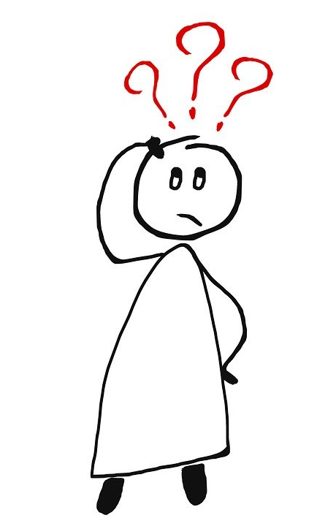
What do these stories tell us about Mary of Bethany?
From these accounts, we can see that Mary of Bethany was a friend and follower of Jesus.
She wanted to learn from Jesus and had faith that he could heal her brother, Lazarus.
She was devoted to Jesus and honoured him by anointing him with expensive oil.
Jesus welcomed her and did not treat her differently because she was a woman.

Slide 14
Let us pray

Slide 15
Closing Prayer
Christ our Lord,
we thank you for the example of Mary of Bethany, who sat at your feet to learn your ways. May we spend time learning more about Jesus’ teachings.
We thank you that Jesus came to Mary of Bethany at her time of grief and despair and cried with her. May we remember that you are always with us and help us to walk alongside those who are sad or afraid.
We thank you that Mary of Bethany always showed her love for you. May we be willing to devote all that we have and are to God.
Amen

Slide 16
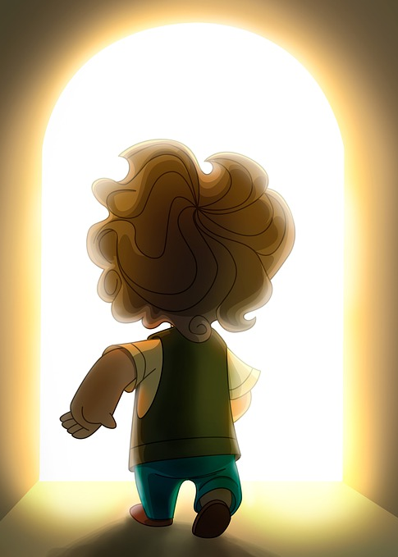
Mission
Mary of Bethany was willing to learn from Jesus and did not let other people discourage her.
How can you make sure that people do not ‘get in the way of God’ for you?
Jesus was with Mary of Bethany when she was worried and sad.
How can you be a good friend to those you know who are sad.
Mary of Bethany adored Jesus.
Write a prayer or poem thanking God for everything that you have been blessed with.

Slide 17
Women in the Bible
Next Week:
Mary Magdalene

