Slide 1
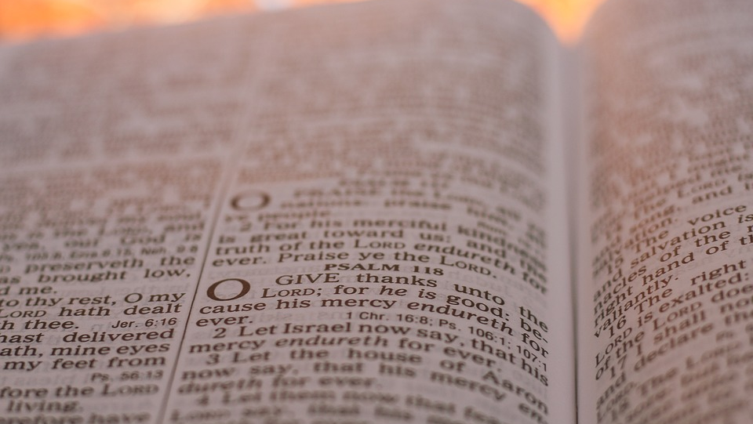



This Week’s Reading:
Exodus 20:1-17
Old Testament Reflection

Slide 2
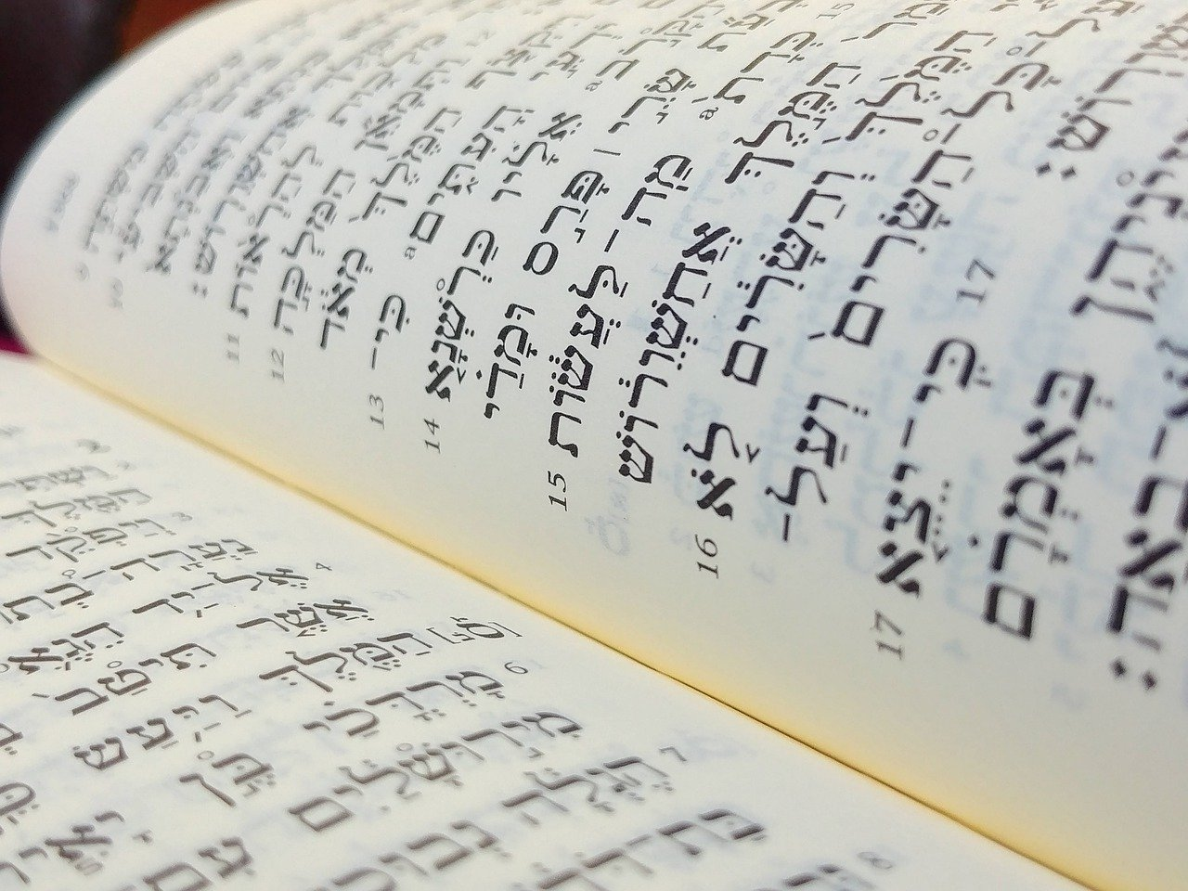
What is the Bible?
Christians believe The Bible is the word of God.
The Bible however is not just one book, but an entire library, with stories, songs, poetry, letters and history.
The Bible has two sections - the Old Testament and the New Testament.
Context

Slide 3
What is the Bible?
The Old Testament is the original Hebrew Bible, the sacred scriptures of the Jewish faith, written at different times between about 1200 BC (Before Christ) and 165 BC.
The New Testament books were written by Christians in the first century AD (Anno Domini) and it contains accounts of Jesus’ life, death and resurrection.
Context

Slide 4
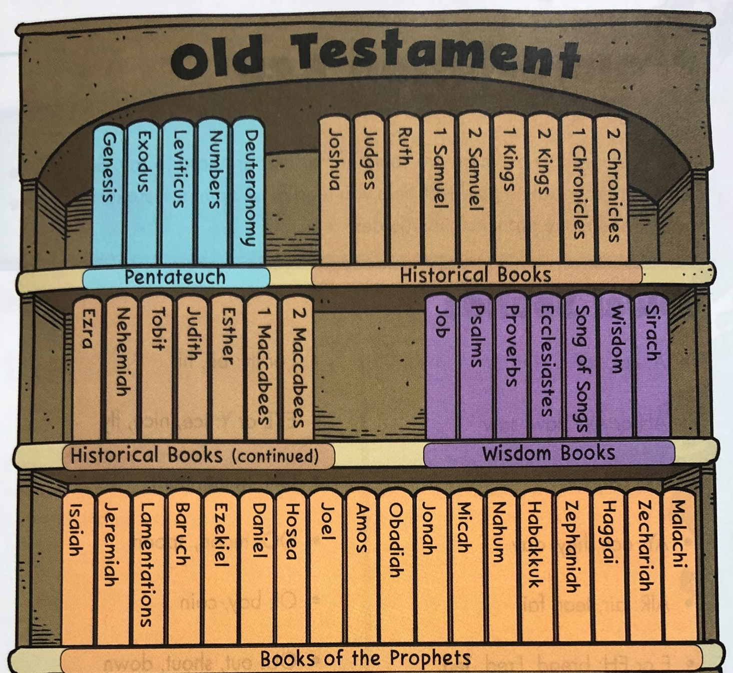
What is The Old Testament?
The Old Testament has 46 books and was written over a long period of time.
It can be arranged into four sections:
The Pentateuch (Law)
The Historical Books
The Wisdom Books
The Prophets
Context

Slide 5
1. The Pentateuch (5 Books)
The first five books, Genesis to Deuteronomy, are not really 'law' Genesis is a book of stories, with nothing like rules and regulations. The other four do contain community laws but they also have many stories. The Hebrew word for Law ('Torah') means 'guidance' or 'instruction', and that could include stories offering everyday examples of how people were meant to live as well. These books were later called the 'Pentateuch’, with Moses being seen as their author.
Context

Slide 6

2. Historical Books
There are 16 ‘Historical Books’ and whilst they are history books, they not only record information, they try to interpret it.
These books try to help people understand the information in these books in relation to other events in the history of Israel, and of the wider world of their day.
Context

Slide 7
3. The Wisdom Books
There are 7 books of wisdom, and these include:
Job (a drama that explores the nature of suffering)
Psalms (songs, prayers and liturgies for worship)
Proverbs (sayings of wisdom)
Song of Songs (love poems)
Context

Slide 8
4. The Prophets
This is the largest section of The Old Testament with 18 books.
These books contain stories of various prophets who reminded people of the values and practices that would reflect the character of God.
Prophecy is a divine message from God and prophets were chosen for different reasons. He gave people opportunities to learn and grow in faith. God wanted His prophets to have to trust Him completely and not rely on their own strength.
Context

Slide 9
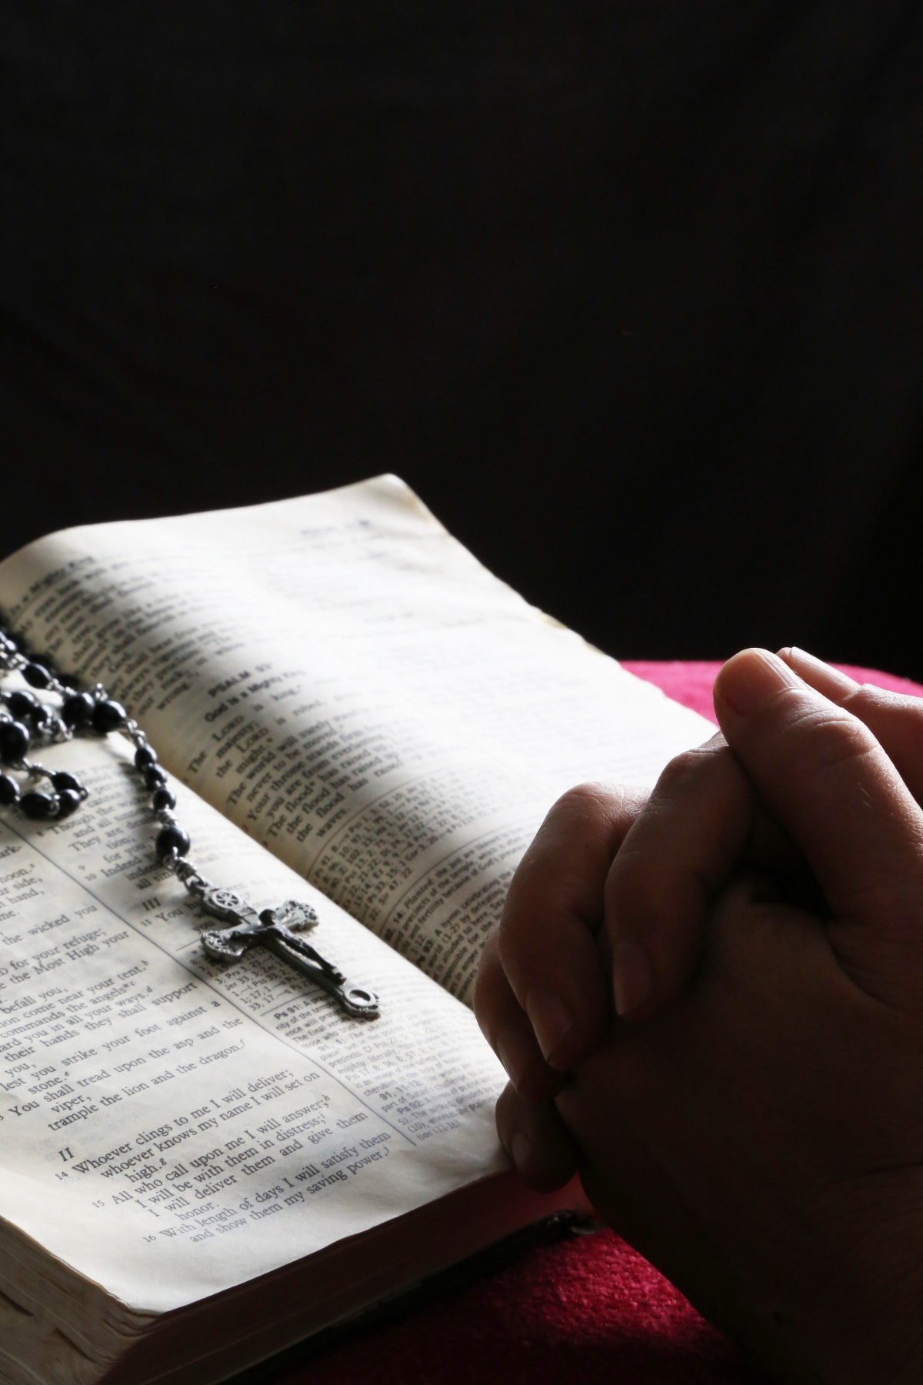
Lord,
Give us wisdom as we prepare to read your word,
clarity for when we read, and understanding whilst we reflect on their meaning.
May your words change our actions and draw us closer to you.
Amen
Gather

Slide 10
Exodus 20:1-17
This Week’s Reading

Slide 11
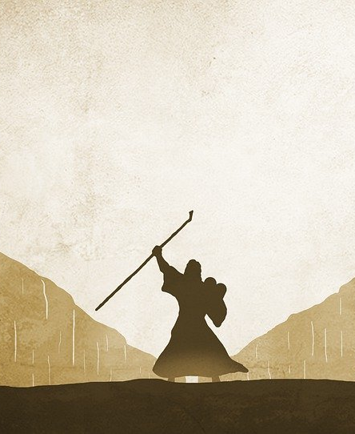
The book of Exodus is the story of God rescuing the children of Israel from Egypt and forging a special relationship with them. Exodus is the second book of the Pentateuch (the five books of Moses), and it’s where we find the stories of the Ten Plagues, the first Passover, the parting of the Red Sea, and the Ten Commandments.
The book gets its name from the nation of Israel’s mass emigration from Egypt and follows Israel out of Egypt into the desert.
This is the book in which God first lays out his expectations for the people of Israel—we know these expectations as the 10 Commandments.
The Book of Exodus

Slide 12

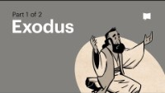
The Book of Exodus

Slide 13
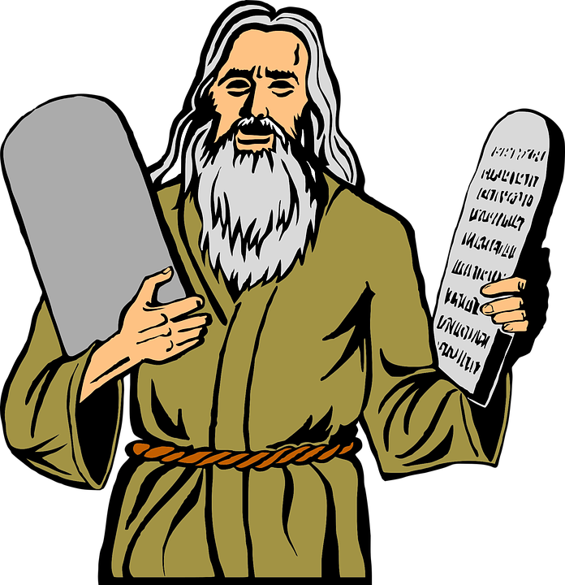
The Law was given through Moses.
And God spoke all these words:
“I am the Lord your God, who brought you out of Egypt, out of the land of slavery.
“You shall have no other gods before me.
“You shall not make for yourself an image in the form of anything in heaven above or on the earth beneath or in the waters below.
Listen: Exod 20:1-17

Slide 14
You shall not bow down to them or worship them; for I, the Lord your God, am a jealous God, punishing the children for the sin of the parents to the third and fourth generation of those who hate me, but showing love to a thousand generations of those who love me and keep my commandments.
“You shall not misuse the name of the Lord your God, for the Lord will not hold anyone guiltless who misuses his name.
“Remember the Sabbath day by keeping it holy.
Listen: Exod 20:1-17

Slide 15
Six days you shall labour and do all your work, but the seventh day is a sabbath to the Lord your God.
On it you shall not do any work, neither you, nor your son or daughter, nor your male or female servant, nor your animals, nor any foreigner residing in your towns.
For in six days the Lord made the heavens and the earth, the sea, and all that is in them, but he rested on the seventh day. Therefore the Lord blessed the Sabbath day and made it holy.
Listen: Exod 20:1-17

Slide 16
“Honour your father and your mother, so that
you may live long in the land the Lord your
God is giving you.
“You shall not murder.
“You shall not commit adultery.
“You shall not steal.
“You shall not give false testimony against
your neighbour.
“You shall not covet your neighbour’s house.
You shall not covet your neighbour’s wife, or
his male or female servant, his ox or donkey,
or anything that belongs to your neighbour.”
Listen: Exod 20:1-17

Slide 17

Why did God give Moses the 10 commandments?
What do you think it means to ‘keep the sabbath day holy’ ?
Which commandment do you think is the most important? Why?
What does this passage tell you about different ‘rules’ that we have to follow in our lives?
Reflect

Slide 18
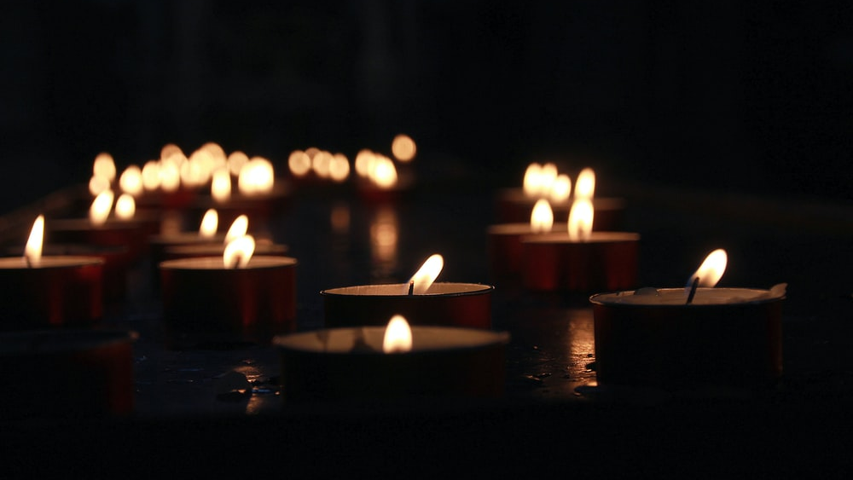
Let us pray

Slide 19
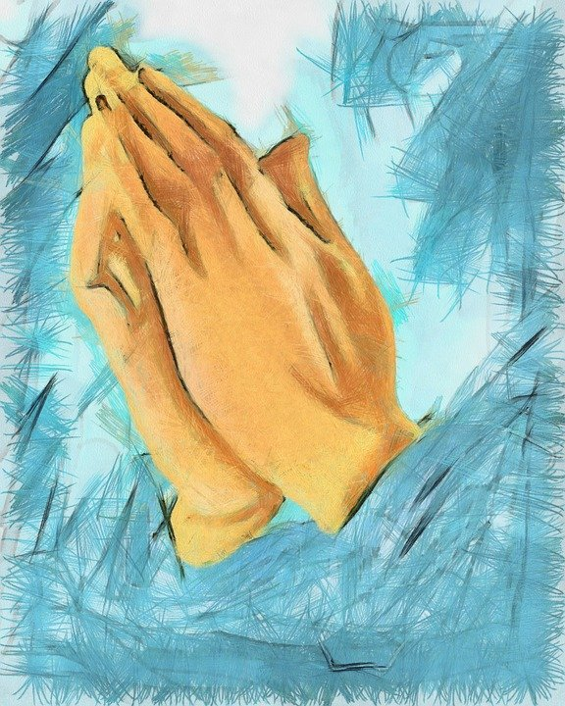
Lord God of creation, I pray today that I keep your commandments.
I want to be more righteous, more loving, and more forgiving.
I love you and know that you love me.
Be with me, guide me, and lead me to do your will.
I ask for your guidance and direction in all that I do, think and say.
Amen

Slide 20
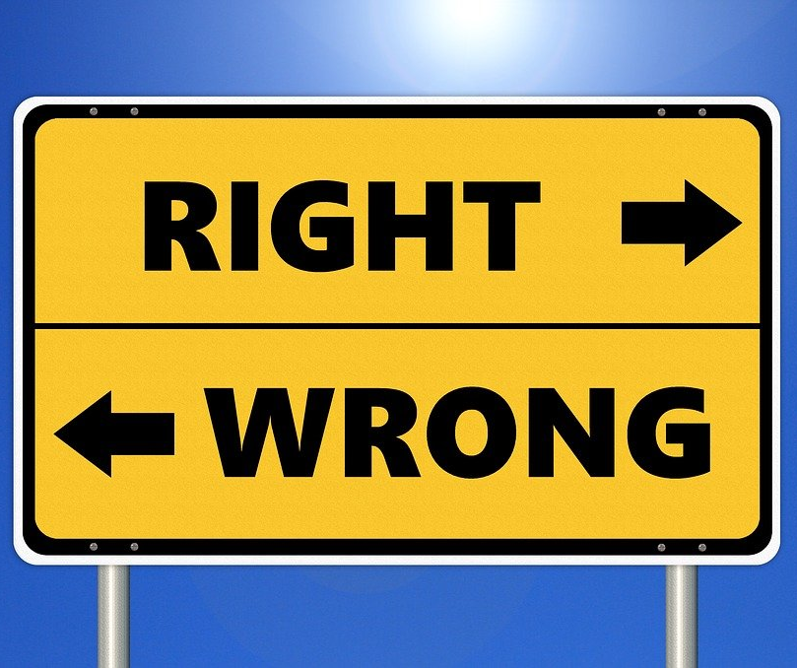
How can we use the 10 commandments to help us to become more like Jesus in our daily lives?
What can you do today to show that you love God above anything else?
At the moment it may be difficult to attend Mass; what could you do to ‘keep the Sabbath holy’?
What do you think it means to ‘honour your father and mother’? How can you do this at home?
Click here for further activities related to the story of Moses and the 10 Commandments.
Mission

Slide 21
Next Week’s Reading:
2Chr 36:14-16, 19-23
Have A Great Week!

