Slide 1
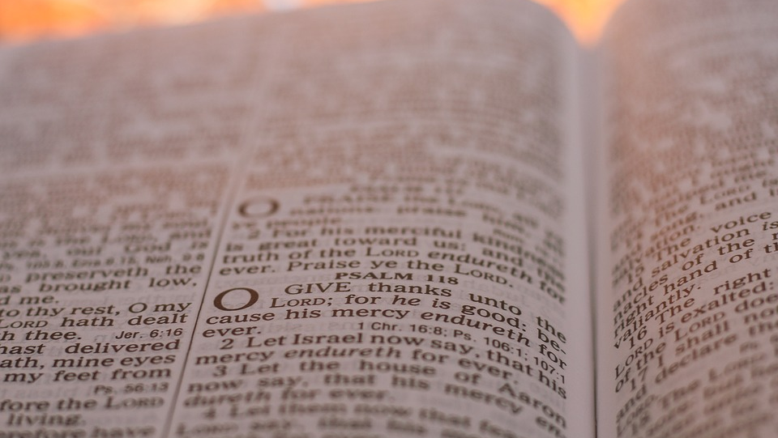

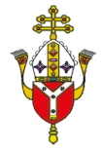

Old Testament Reflection

Slide 2
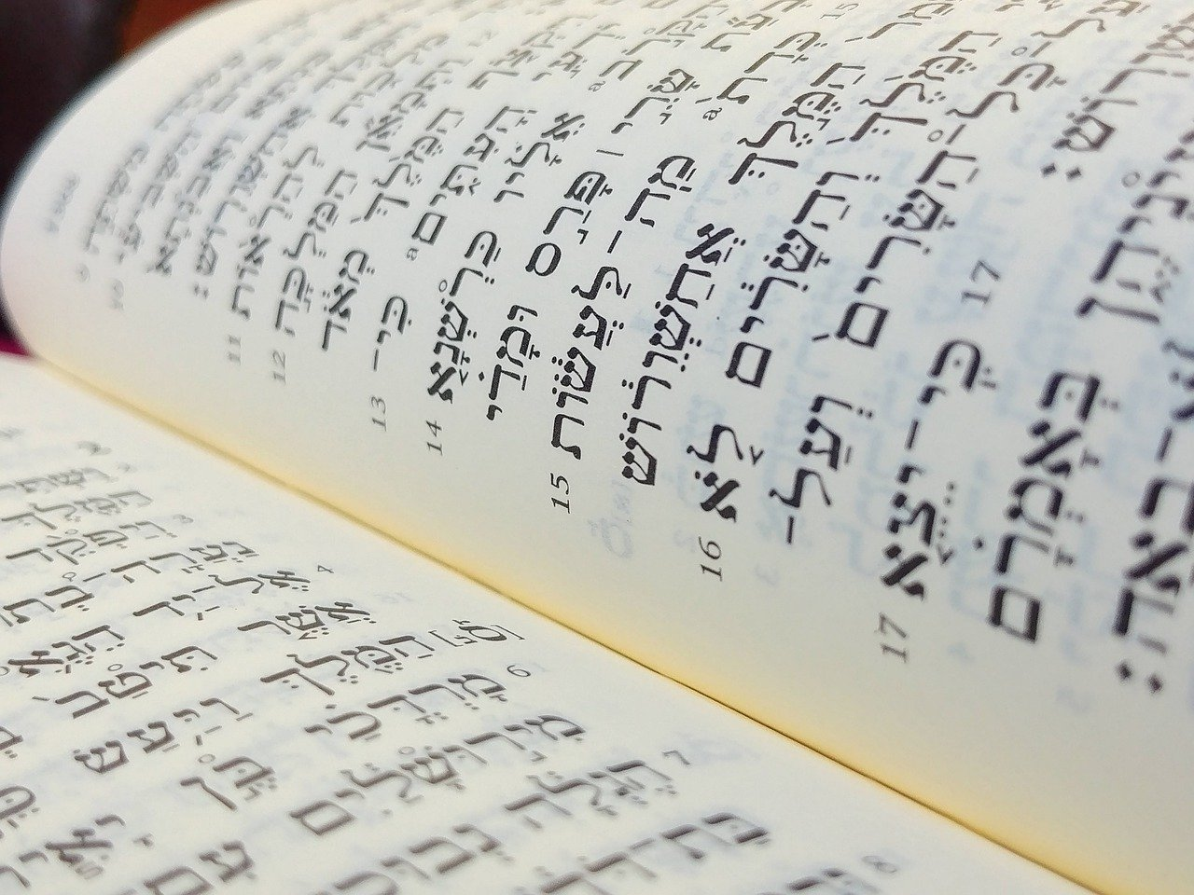
What is the Bible?
Christians believe The Bible is the word of God.
The Bible however is not just one book, but an entire library, with stories, songs, poetry, letters and history.
The Bible has two sections - the Old Testament and the New Testament.
Context

Slide 3
What is the Bible?
The Old Testament is the original Hebrew Bible, the sacred scriptures of the Jewish faith, written at different times between about 1200 BC (Before Christ) and 165 BC.
The New Testament books were written by Christians in the first century AD (Anno Domini) and it contains accounts of Jesus’ life, death and resurrection.
Context

Slide 4
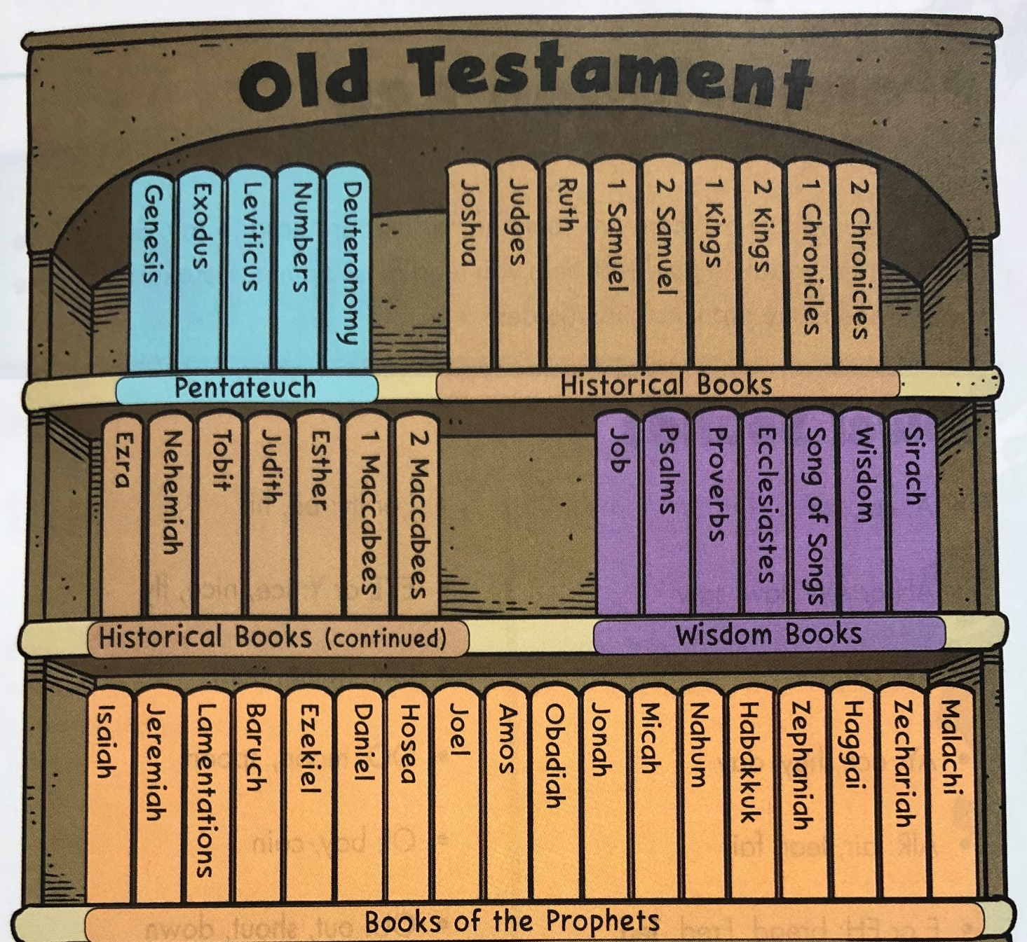
What is The Old Testament?
The Old Testament has 46 books and was written over a long period of time.
It can be arranged into four sections:
The Pentateuch (Law)
The Historical Books
The Wisdom Books
The Prophets
Context

Slide 5
1. The Pentateuch (5 Books)
The first five books, Genesis to Deuteronomy, are not really 'law' Genesis is a book of stories, with nothing like rules and regulations. The other four do contain community laws but they also have many stories. The Hebrew word for Law ('Torah') means 'guidance' or 'instruction', and that could include stories offering everyday examples of how people were meant to live as well. These books were later called the 'Pentateuch’, with Moses being seen as their author.
Context

Slide 6

2. Historical Books
There are 16 ‘Historical Books’ and whilst they are history books, they not only record information, they try to interpret it.
These books try to help people understand the information in these books in relation to other events in the history of Israel, and of the wider world of their day.
Context

Slide 7
3. The Wisdom Books
There are 7 books of wisdom, and these include:
Job (a drama that explores the nature of suffering)
Psalms (songs, prayers and liturgies for worship)
Proverbs (sayings of wisdom)
Song of Songs (love poems)
Context

Slide 8
4. The Prophets
This is the largest section of The Old Testament with 18 books.
These books contain stories of various prophets who reminded people of the values and practices that would reflect the character of God.
Prophecy is a divine message from God and prophets were chosen for different reasons. He gave people opportunities to learn and grow in faith. God wanted His prophets to have to trust Him completely and not rely on their own strength.
Context

Slide 9
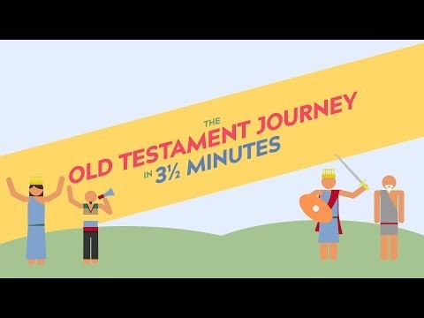
What is the Old Testament?

Slide 10
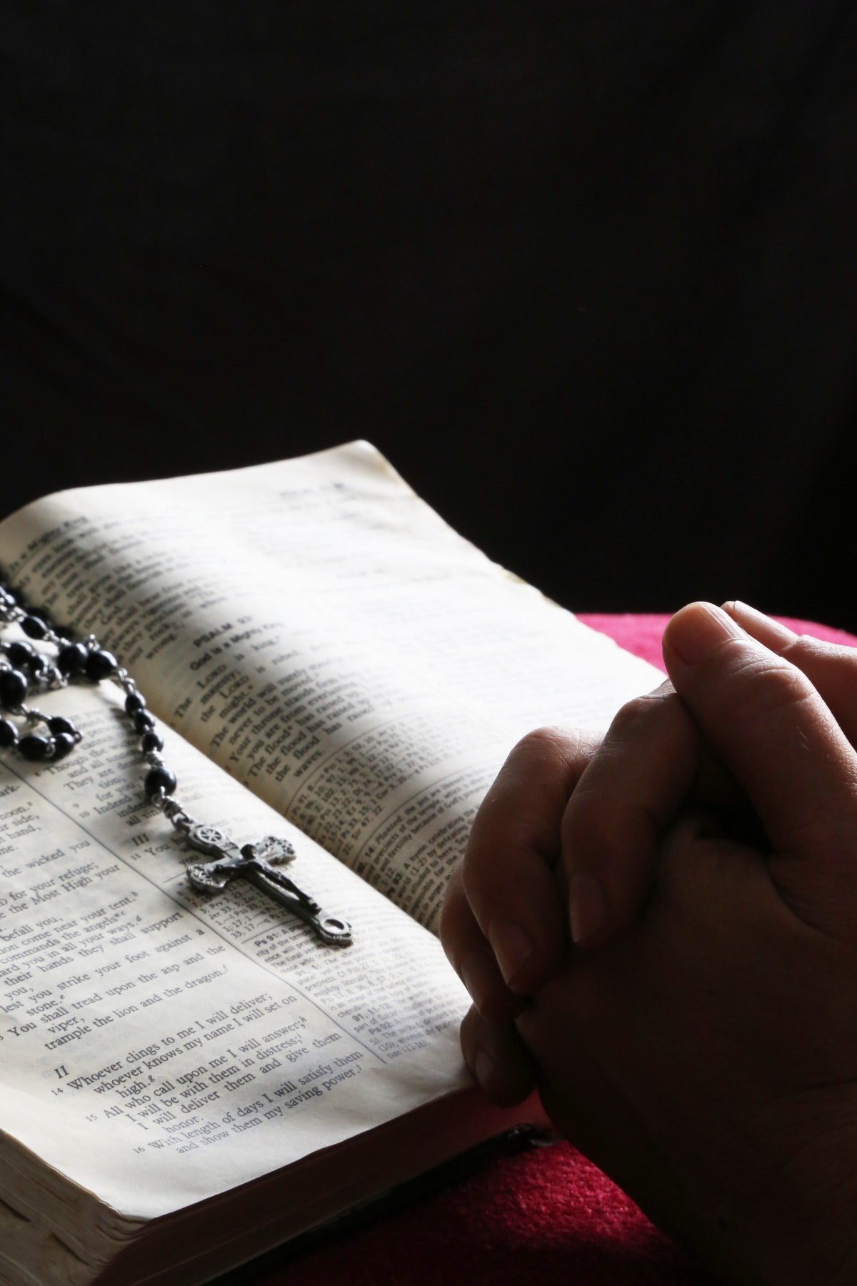
Lord,
Give us wisdom as we prepare to read your word,
clarity for when we read, and understanding whilst we reflect on their meaning.
May your words change our actions and draw us closer to you.
Amen
Gather

Slide 11
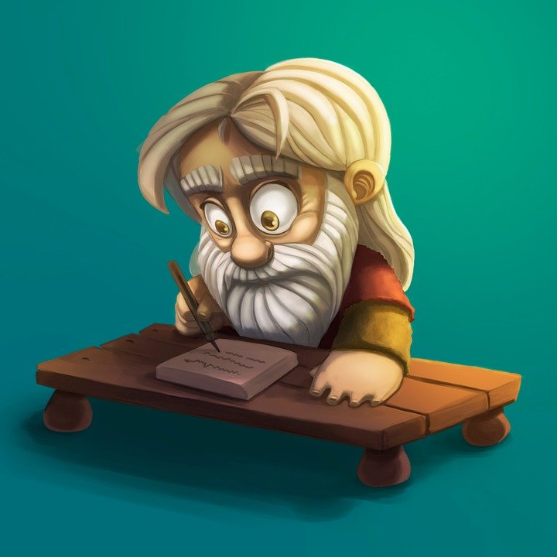
‘I will raise up a prophet and put my words into his mouth’
Moses said to the people: ‘The Lord your God will raise up for you a prophet like myself, from among yourselves, from your own; you must listen. This is what you yourselves asked of the Lord your God at Horeb on the day of the Assembly. “Do not let me hear again” you said “the voice of the Lord my God, nor look any longer on this great fire, or I shall die”;
Listen (Deuteronomy 18:15-20)

Slide 12
and the Lord said to me, “All they have spoken is well said. I will raise up a prophet like yourself for them from their own; I will put my words into their mouth and they shall tell them all I command. The person who does not listen to my words that is spoken in my name, shall be held answerable to me for it. But the prophet who presumes to say in my name a thing I have not commanded to say, or who speaks in the name of other gods, that prophet shall die.”’
Listen (Deuteronomy 18:15-20)

Slide 13

What do you think this Old Testament reading means?
Who is the ‘prophet’ it is referring to?
In which way can you live out the message?
How can you be a modern day prophet and speak out ‘all that God commands’?
Reflect

Slide 14
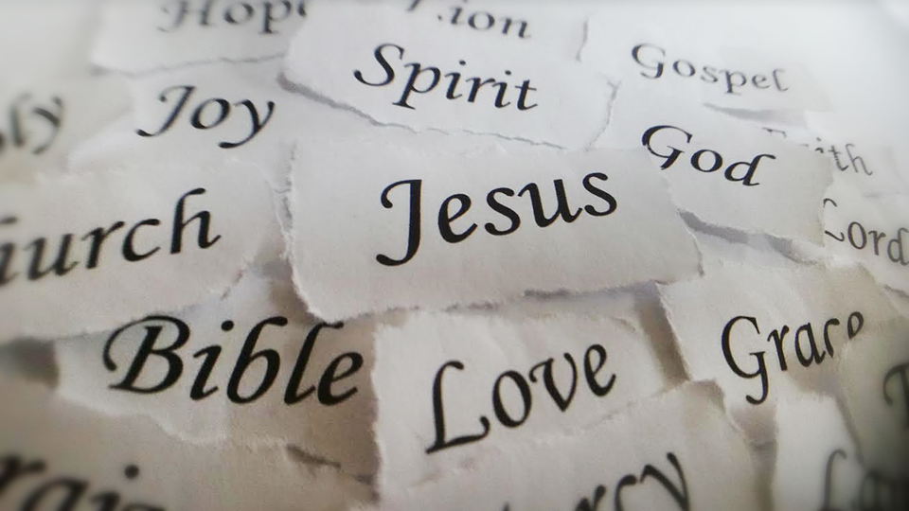
Let us pray

Slide 15
We give thanks to you, our God
For all the prophets in times past:
David and Deborah, Jacob and Jonah…
And for sending Jesus who surpasses all prophets.
As Jesus said:
"When you lift up the Son of Man, then you will know that I am he, and I do nothing on my own initiative, but I speak these things as the Father taught me (John 8:28)
May we learn from Jesus and speak up in our own times for all that is right, just and good.
Amen

Slide 16
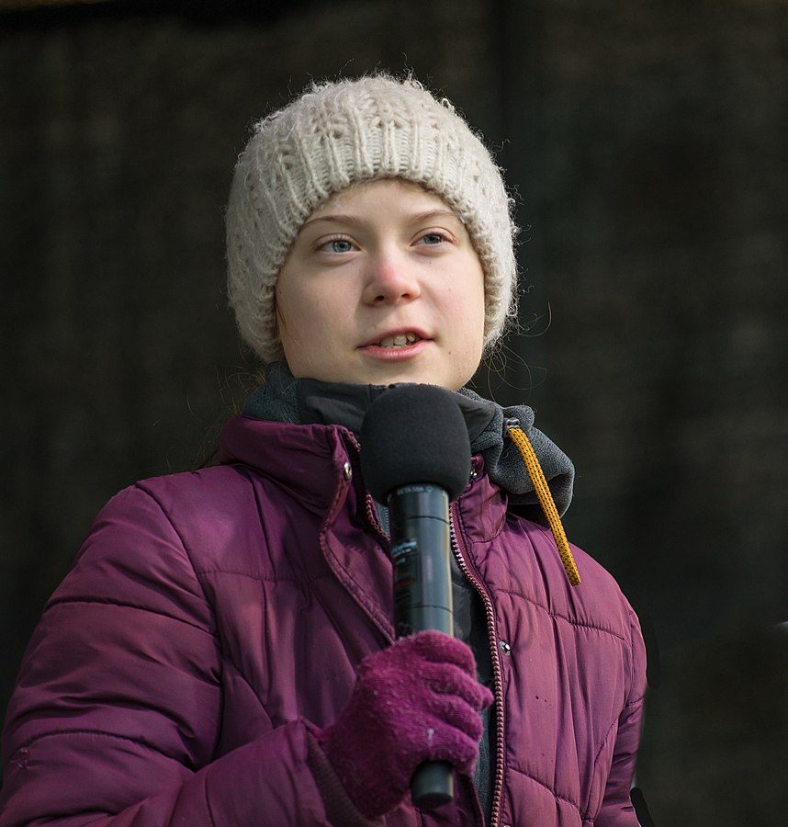
In the Old Testament the prophets spoke for God. They brought the word of God to a people who needed to be reminded of it. They were not trying to predict the future…that idea came along much later in the history of prophecy. The prophets were saying something important about the present.
How can you be prophets of ‘today’?
What would God want you to say?
What do you see happening in the world today that is not right or just?
What can you do about these ‘injustices’?
Mission

