Slide 1

Women in the Bible
Anna

Slide 2
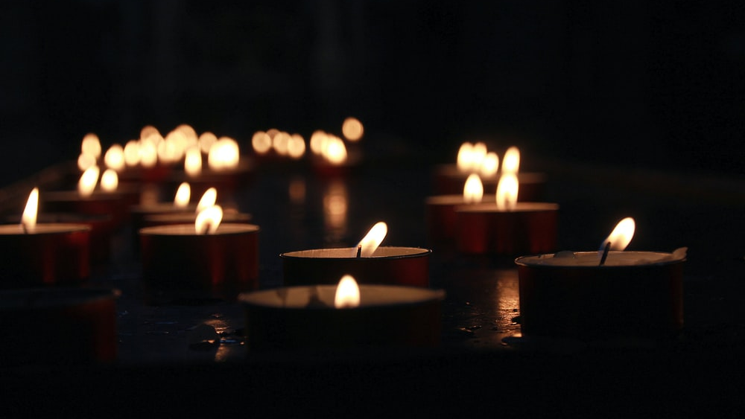
Let us pray

Slide 3

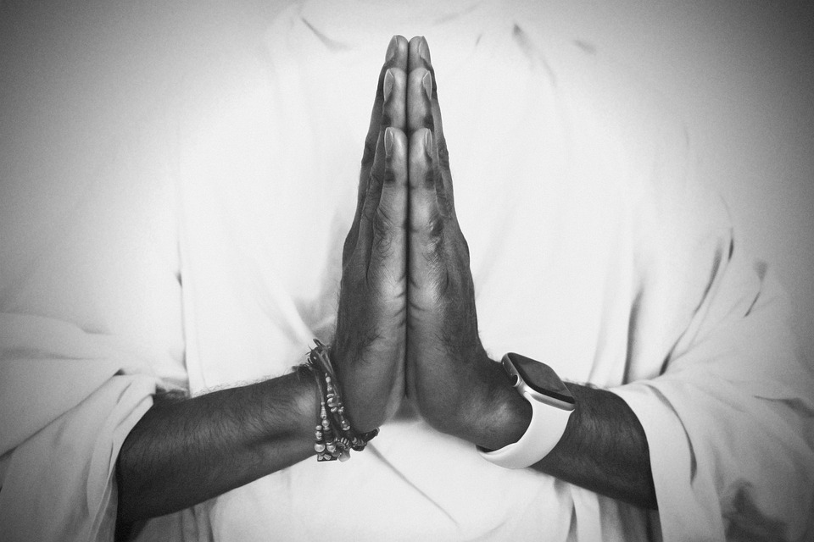
Opening Prayer
Risen Lord, The angel that announced your rising spoke to an audience of but a few women from Galilee.
And then you appeared, risen in the body, but first only to Mary of Magdala.
We look back on all the centuries of your Church.
Born of this small, faithful band, nurtured through the ages so often by the special grace given to women.
Lord, teach us to honour women, in body and in spirit.
For these great disciples have taught us to heal the sick, to feed the poor, to sow mercy and justice and
to make peace.
And we call on them now to pray for us, As we take up the cross ourselves.

Slide 4
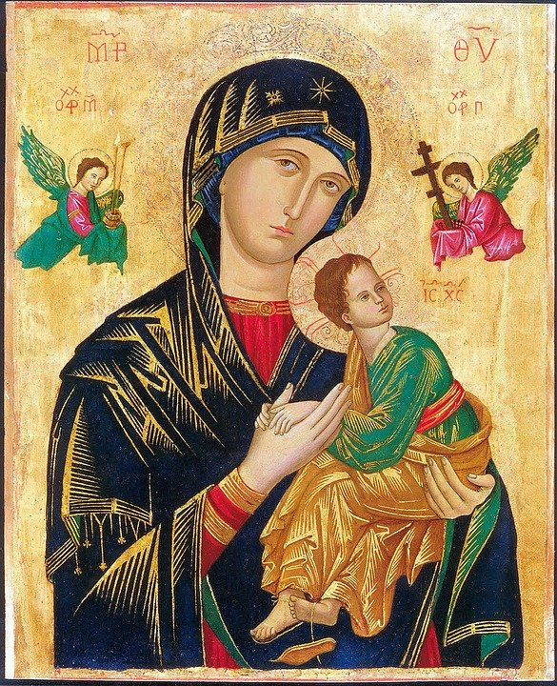
Women in the Bible
There are many notable female characters and heroes across scripture. A few, including Ruth, Esther, and Judith, emerge as especially prominent and even have whole books named after them; but there are others that have only a small appearance in the Bible, some as few as one verse.
Many of the women in the Bible were strong, capable women; they didn’t sit around waiting for someone else to get the job done. They feared God and lived faithfully. They did what they needed to do.
God empowered all women to be strong and follow his call, and he used the actions of these women to inspire and teach us years later through the biblical text.

Slide 5
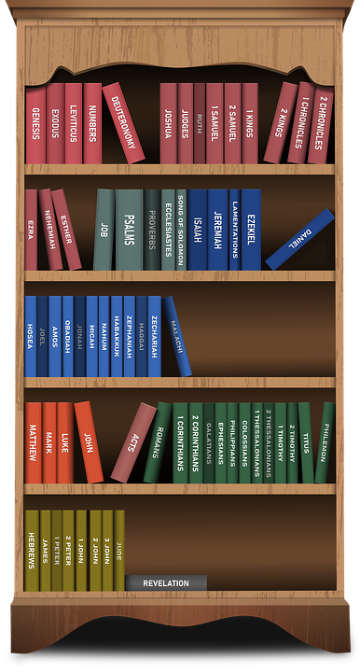
Women in the New Testament
This series will now consider women from the New Testament.
It will include women Jesus met and those who played important roles in the early Church. Women at this time had few rights and were dependent on their fathers and husbands.
They did not go to school and could not vote. There main role was as a daughter, wife and mother…but these women had other ideas!

Slide 6
Anna

Slide 7

Anna
Anna was a descendant from the Jewish tribe of Asher and was a prophetess.
A prophetess is a female prophet. The word prophet comes from the Greek word prophetes, which means “spokesman.” A prophet in the Bible is a person who proclaims God’s Word and therefore speaks for God - a spokesman for God. A prophetess was, therefore, a ‘spokeswoman’ for God.

Slide 8
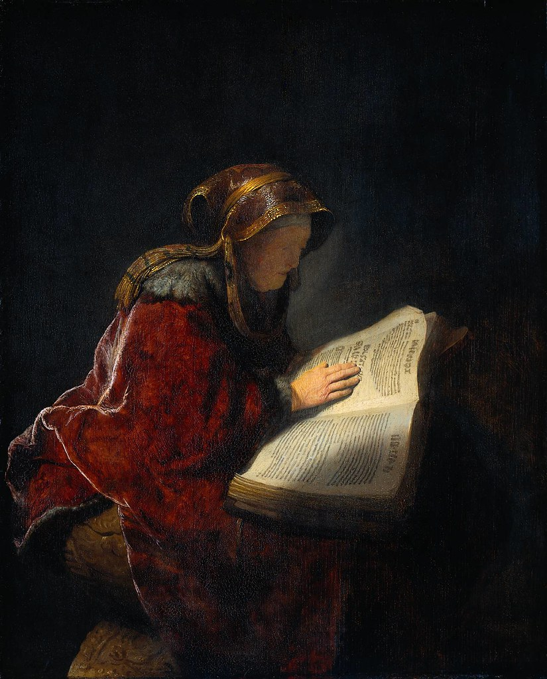
Anna
From the Gospel of Luke we find out that Anna was elderly and a widow. She spent her time worshipping God with regular fasting and praying. She was also one of the first people to recognise, that Jesus was God’s promised Messiah.

Slide 9
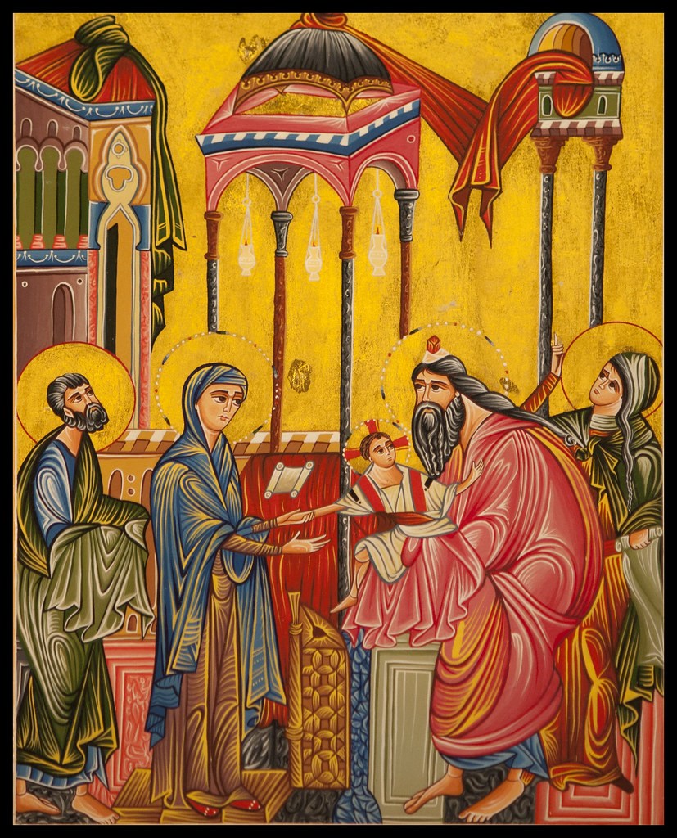
Luke 2: 36 – 38
‘There was also a prophet, Anna the daughter of Phanuel, of the tribe of Asher. She was of a great age, having lived with her husband seven years after her marriage, then as a widow to the age of eighty-four. She never left the temple but worshiped there with fasting and prayer night and day. At that moment she came, and began to praise God and to speak about the child to all who were looking for the redemption of Jerusalem.’

Slide 10

The Story of Anna

Slide 11
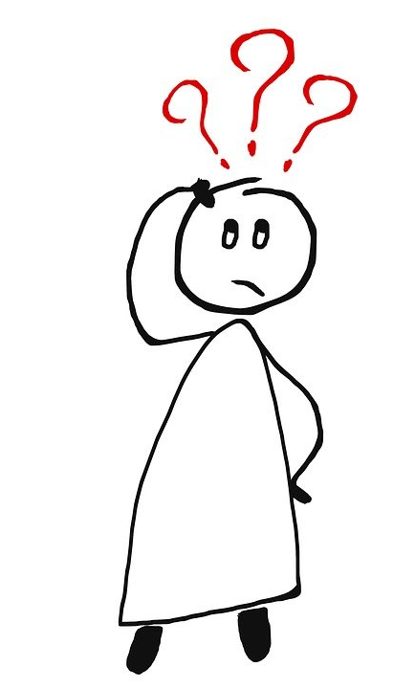
What does this story tell us about Anna?
From this story, we can see that Anna was devoted to her faith and was a ‘prophetess’.
How do you think her faith was linked to her being a prophetess?
Anna ‘began to praise God and to speak about the child to all who were looking for the redemption of Jerusalem.’
What was Anna talking about?
Why was Anna brave to do this?

Slide 12
Let us pray

Slide 13
Closing Prayer
Christ our Lord,
we thank you for the example of Anna, who met you when you were just a baby.
May we be as faithful as her in following you and make time each day to pray.
May this then help us draw closer to you so like Anna we can have a true understanding of who you are as our redeemer.
May we then have the courage to share this with others as Anna did.
Amen

Slide 14
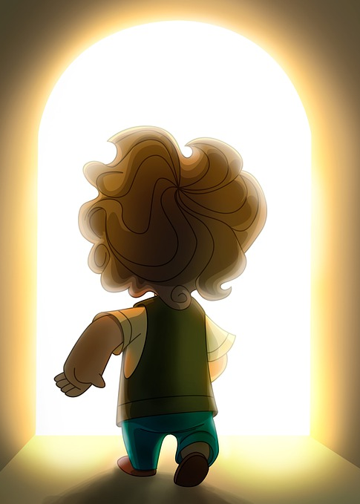
Mission
Anna dedicated her life to prayer and fasting.
What can you do to show your commitment to God in your everyday life?
Prayer was very important to Anna.
Think about how you ‘pray’ and ‘talk to God’.
Do you have a ‘favourite’ prayer or a preferred way of praying?
Can you compose your own prayer dedicated to Anna?
Anna recognised that Jesus was the Messiah.
How do people ‘recognise’ that you are a follower of Jesus?

Slide 15
Women in the Bible
Next Week:
Mary

